Slide 1

How can a global perspective on the circular economy for textiles provide benefits worldwide?
Notes:
The following slides are about taking a global perspective on the circular economy, with the clothing value chain serving as an example. They shows how activities in different parts of the world are related, and how social and economic benefits could be achieved by integrating the circular potential of the Global South into these value chains, whereas a one-sided focus on European/Dutch circularity may disregard these benefits.

Slide 2
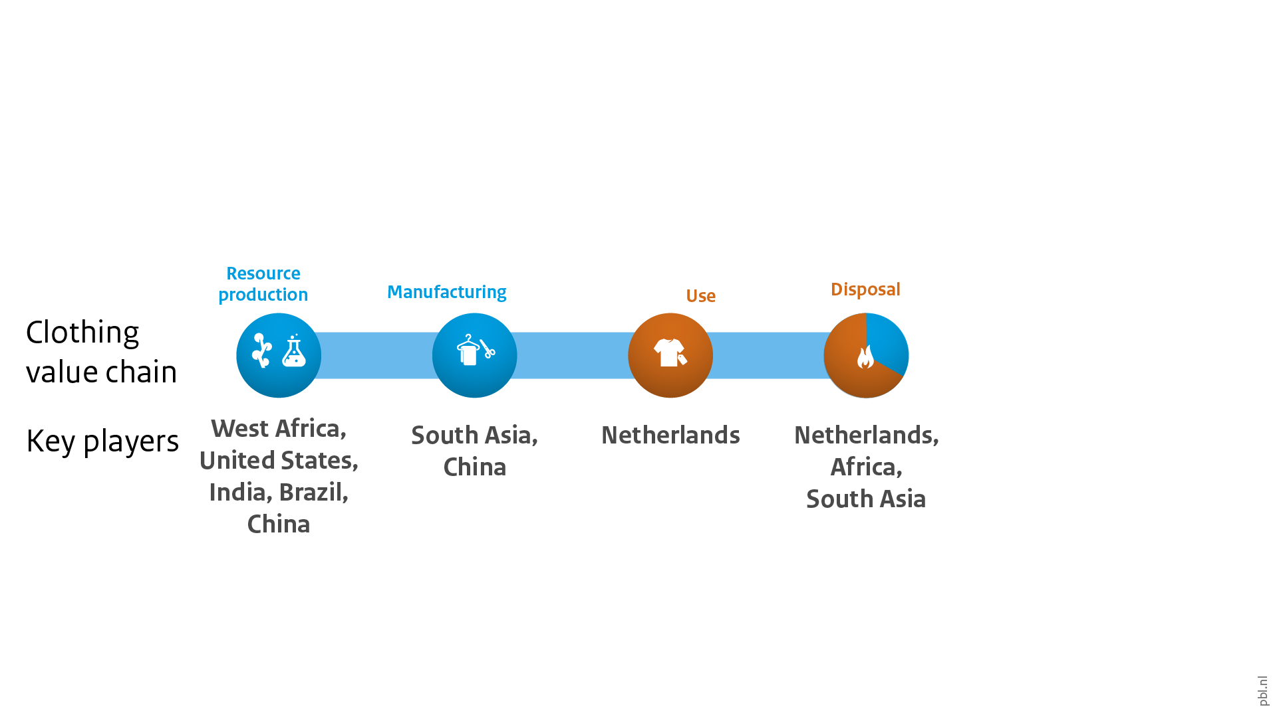
The clothing value chain is highly international
Notes:
This is what a typical clothing value chain looks like, with the Netherlands as an example. As you can see, it is a very linear chain. Raw materials, such as polyester and cotton, are produced, processed and used in the manufacture of clothing. This clothing, once it is discarded by its users, mostly ends up in municipal waste streams, where it is either incinerated or landfilled. The only remotely 'circular' aspect of this process is the recovery of energy from waste incineration.

Slide 3
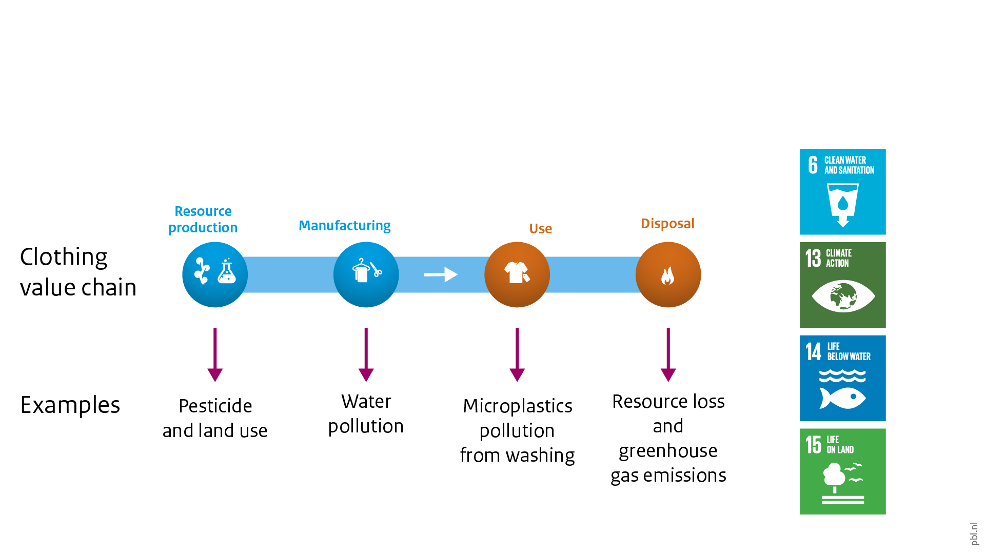
Large amounts of waste and pollution in value chain
Notes:
The various stages of this chain generate waste and pollution; thus, negatively affecting environmental SDGs. Examples are:
pesticides and land use in resource production (especially of cotton), affecting biodiversity
water pollution caused by manufacturing processes
microplastics affecting marine life
large-scale resource disposal – in the Netherlands, this is often done by incineration

Slide 4
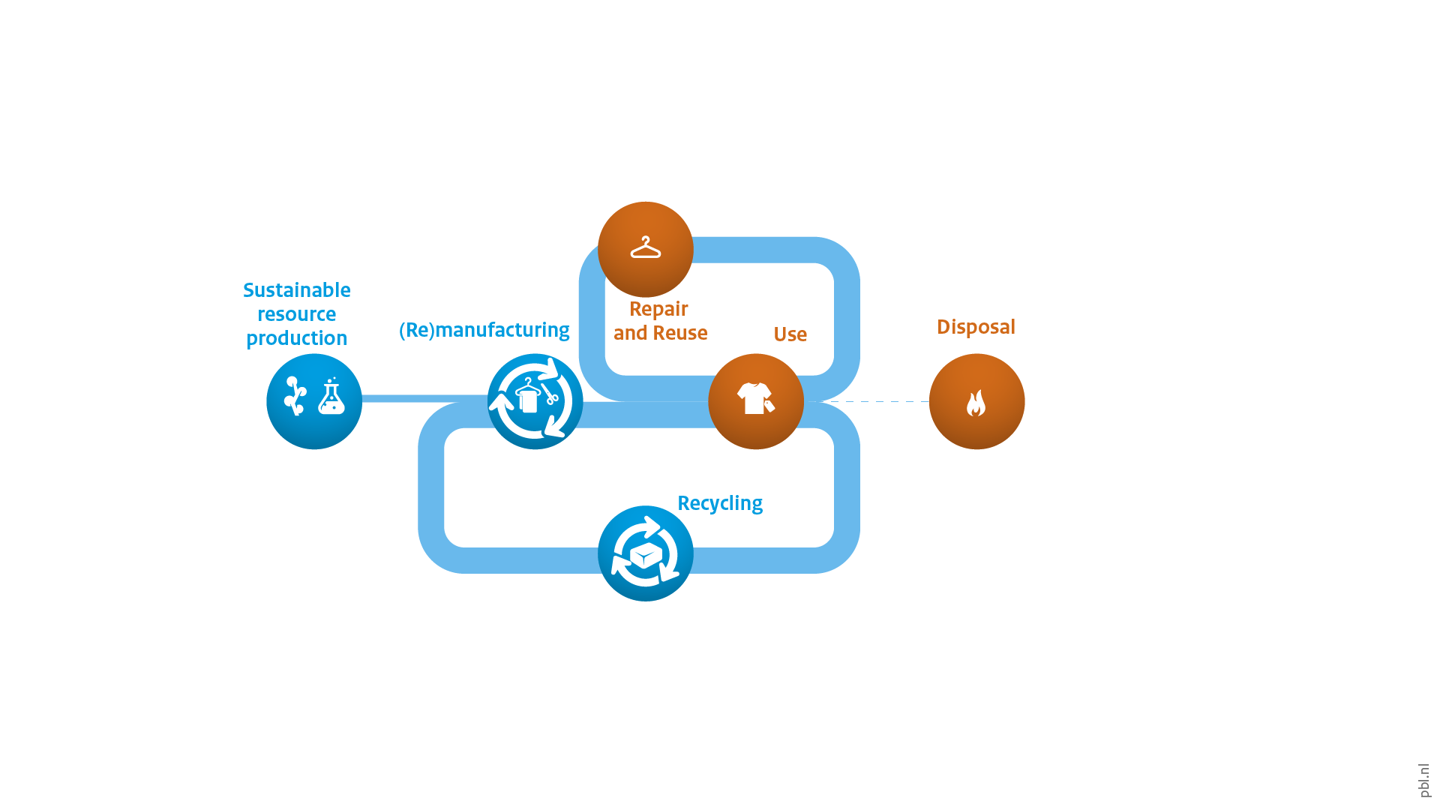
Current NL/EU circular economy ambition
Notes:
These environmental issues have given rise to ambitions for a circular clothing sector. Currently, in the EU and the Netherlands, these ambitions emphasise the need for the reuse and recycle of clothing, alongside attention for the production of sustainable raw materials. This would decrease the amount of waste that is produced, slowing and closing material loops.

Slide 5
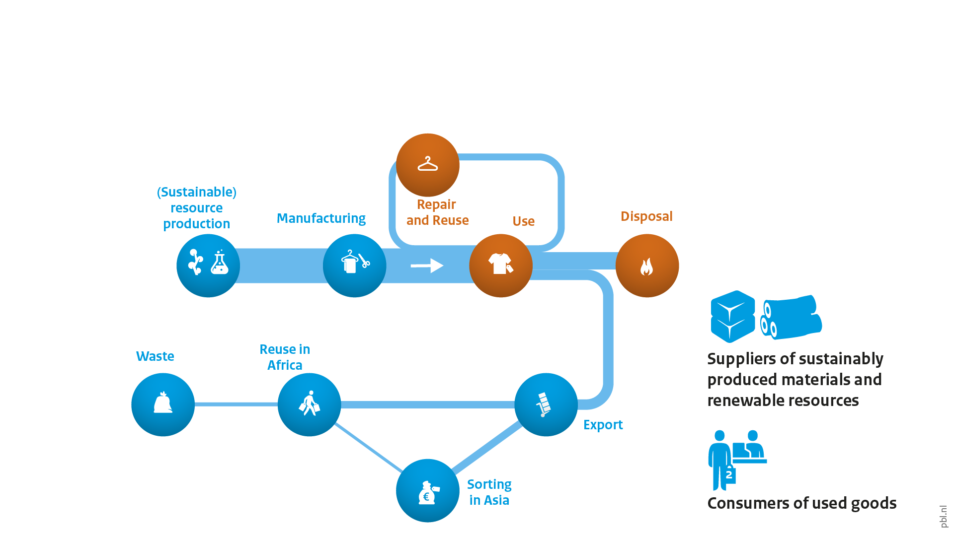
Disregarding existing circularity elsewhere
Notes:
EU and Dutch circular clothing ambitions do not seem take account of an important part of the existing value chain. Most of the discarded clothing that is collected separately finds its way abroad. Large markets for used clothing from the European Union in the Global South. African countries are main destinations for used clothes, and there are several sorting and grading hubs the United Arab Emirates and Pakistan, amongst others. In Pakistan and India, old clothing that is not suitable for reuse is often downcycled into fibres used for making rags, blankets or other low-quality textiles. Together, this means that low-income countries have two roles fitting with a circular economy: by supplying sustainable resources and by re-using goods. However, textile waste does form a serious problem in Africa, where low-quality 'fast-fashion' used clothing that remains unsold ends up being dumped, as there is no suitable waste processing infrastructure.

Slide 6
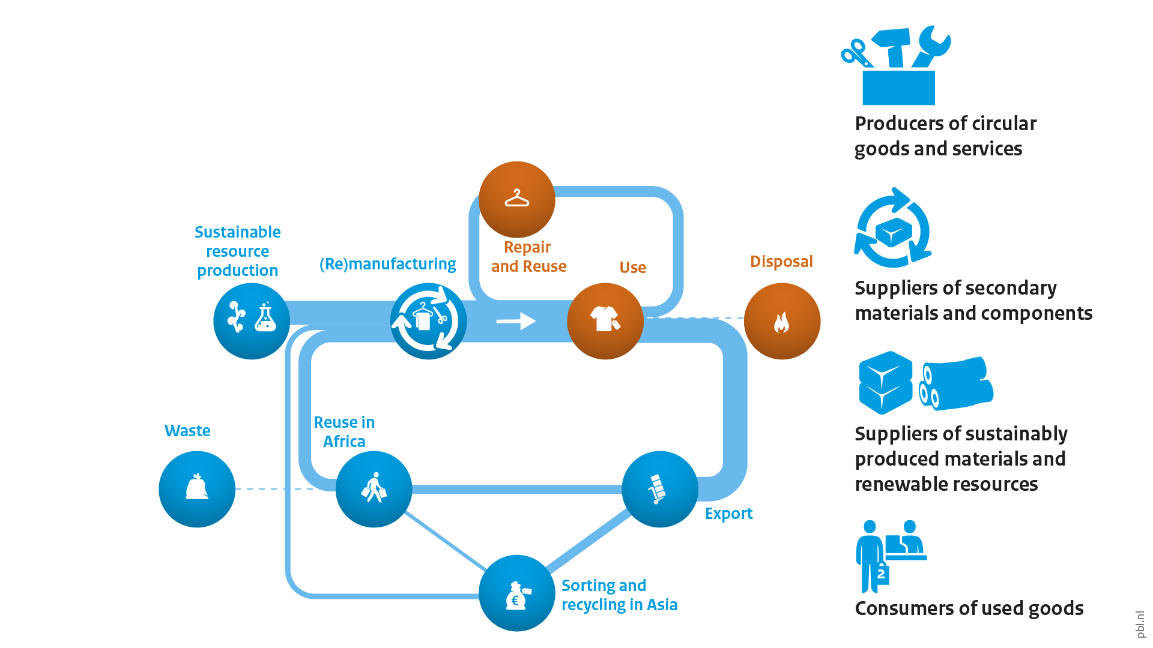
Opportunities from global circular strategies
Notes:
Looking at this existing value chain, there is room for EU and Dutch circular ambitions to take a more global perspective. This perspective would seek to close the loop, in a global sense, and broaden the role of low-income countries also supplying recycled materials and using them in manufacturing. An effective strategy would be one that targets the parts of the value chain with lowest resource efficiency, such as the incineration of discarded clothing in the European Union and the dumping of unwanted clothing in Africa. Furthermore, overall clothing production volumes could be reduced, with a shift towards higher quality, more durable, repairable and more easily recycled garments. This could generate environmental gains, as well as benefit people in the Global South who are involved in the trade, processing and use of second-hand clothing.

Slide 7
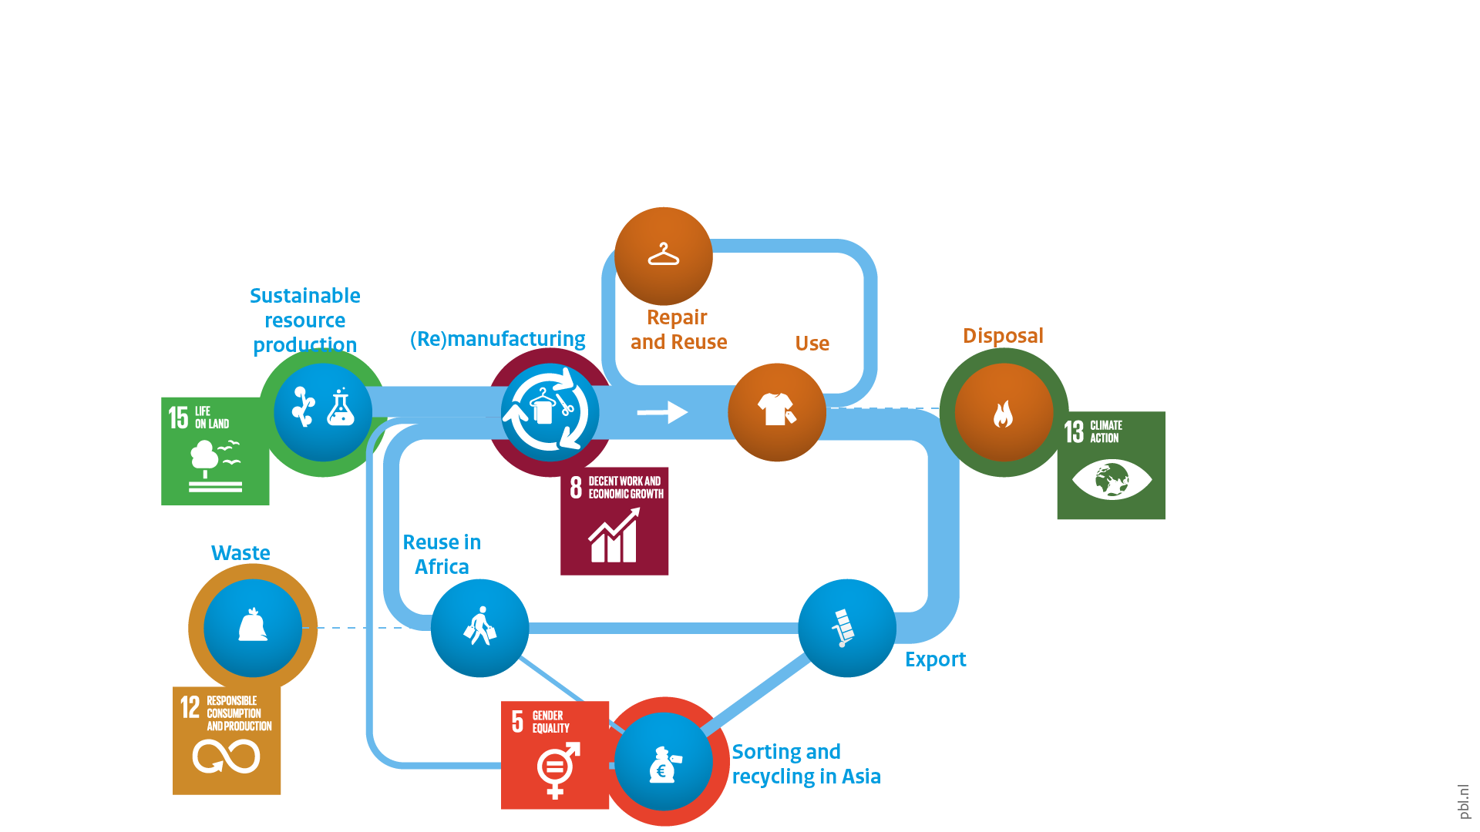
Examples of potential SDG benefits
Notes:
Such a global perspective may also lead to various SDG-related benefits. Not in the least in relation to environmental goals, but also socio-economically. Incorporating countries in the Global South into a global circular clothing economy would also create employment opportunities in sorting, grading, repairing and recycling clothing. Most jobs in the sorting, grading and repair of clothes for reuse will continue to be manual and are currently female-dominated, whereas sorting and grading for recycling can be automated. Investment in these jobs can focus on creating decent work, with good working conditions and decent wages. Clothing that is no longer fit to be reused could be diverted from dumpsites to recycling facilities, to be reincorporated into the manufacture of new products, thereby improving the environmental outcome through higher material value retention. In addition, used clothing of good quality does form a source of affordable clothes for very large groups of people in the Global South, with up to 90% of people in some African countries wearing predominantly used clothing.

Slide 8
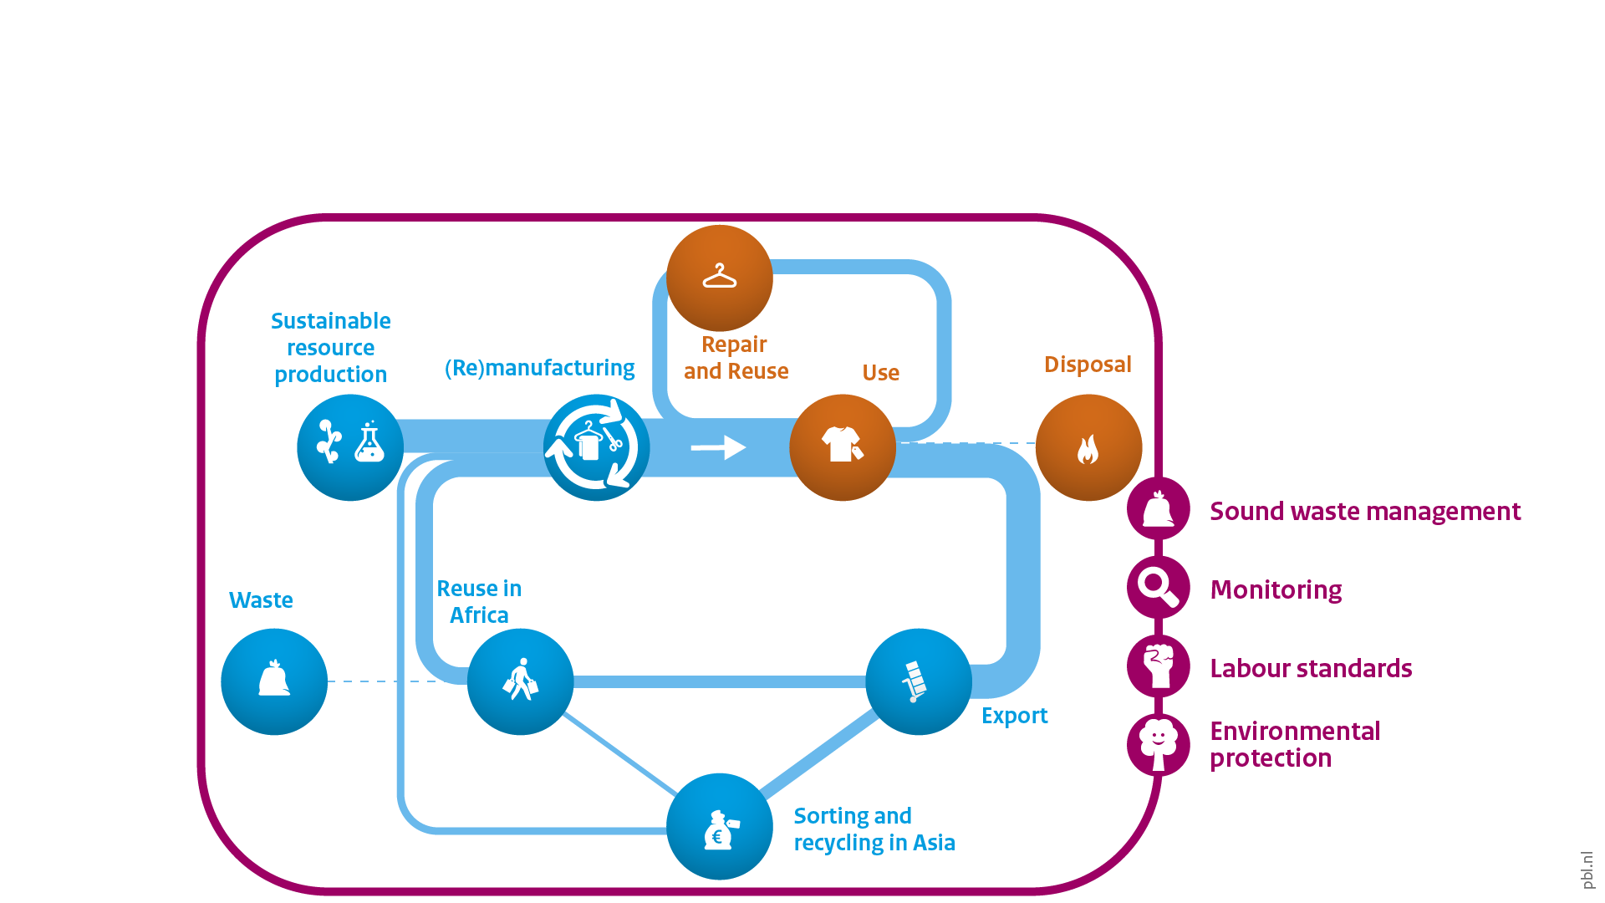
Preconditions remain essential
Notes:
In all this, it remains essential to emphasise preconditions for a more global circular economy. It is vital, in this regard, to decrease overall textile production volumes, and there needs to be a focus on rethinking material use: design for longevity, durability, repair, and recyclability. Quality over quantity. In addition, already existing preconditions that seek to avoid externalising costs onto people and the environment in the Global South remain essential. This requires a focus on labour rights, health risks, and environmental standards. Monitoring, reporting and accountability tools will need to be developed to keep track of trade flows and impacts throughout the value chains.

Slide 9
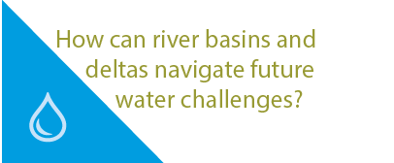


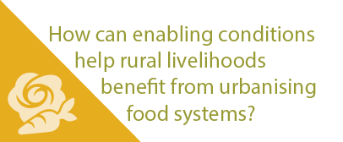
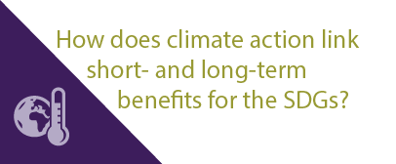
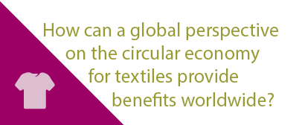
More stories at pbl.nl/ig22
This presentation

