Slide 1

How does climate action link short- and long-term benefits for the SDGs?
Notes:
Several measures are being implemented to achieve long-term climate goals. A key question concerns the short-term effects of these measures on other SDGs.

Slide 2

Effect of long-term climate action on SDGs
Notes:
There are ‘good practice’ climate mitigation measures that have already been successfully implemented around the world. These measures can be used today to achieve long-term climate mitigation goals.

Slide 3
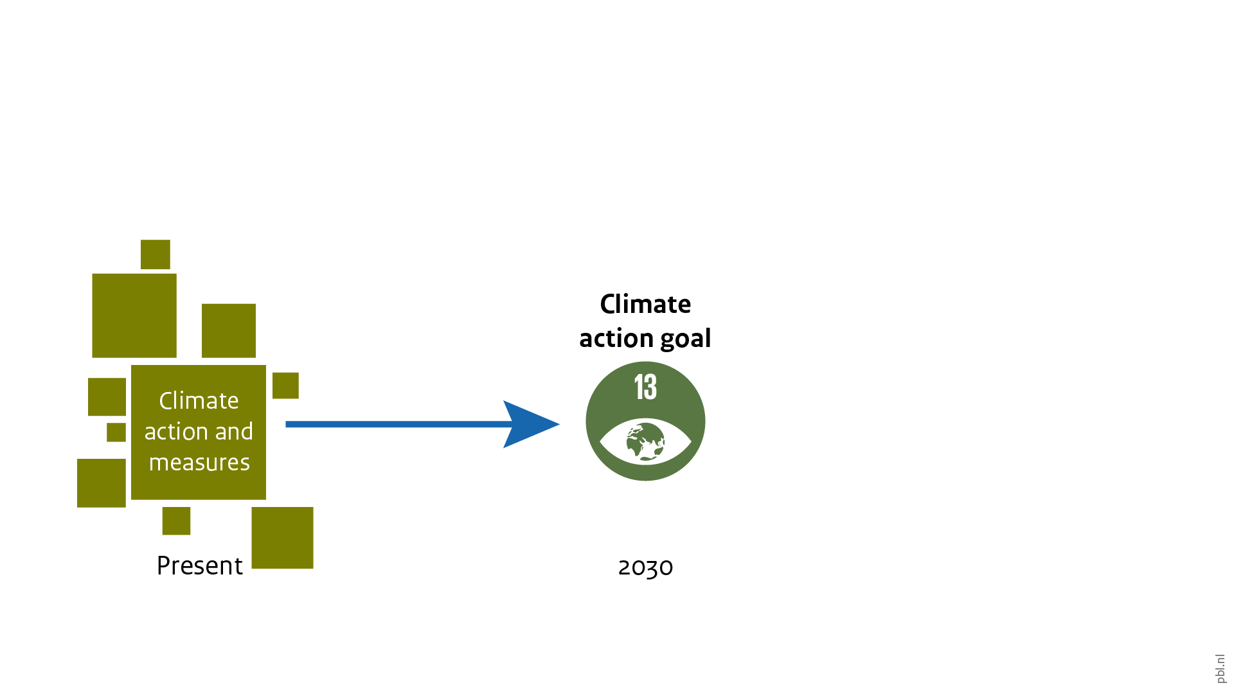
Effect of long-term climate action on SDGs
Notes:
These measures contribute to achieving SDG 13 – ‘take urgent action to combat climate change and its impacts’ in the short term.

Slide 4
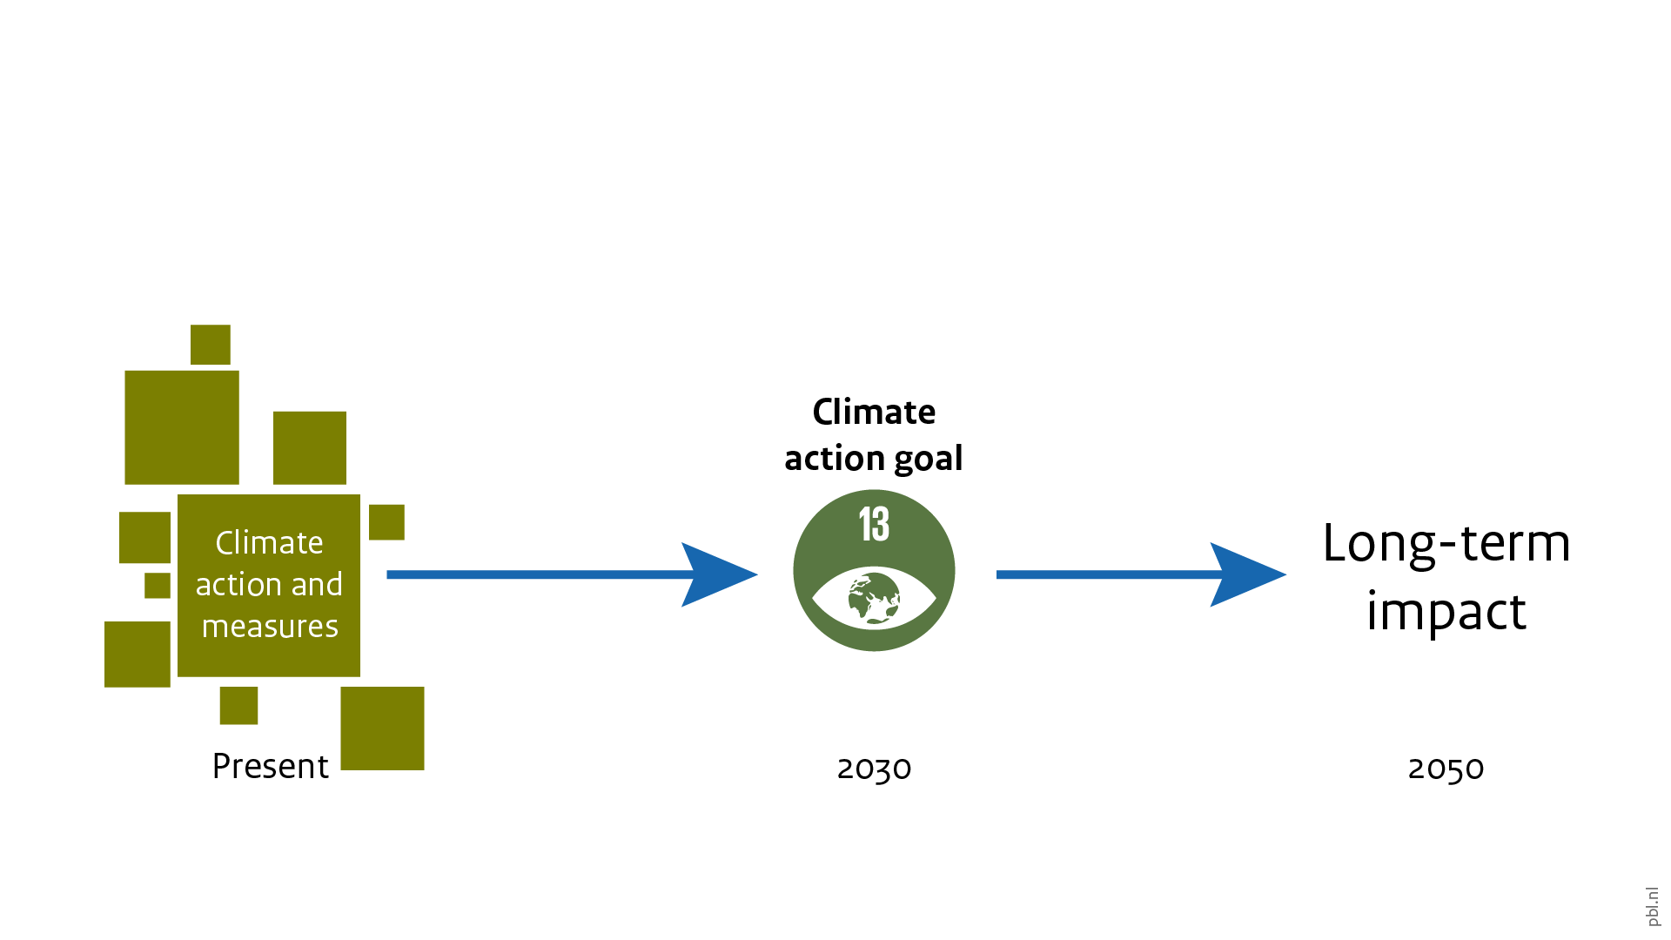
Effect of long-term climate action on SDGs
Notes:
And, in the long-term, these measures contribute to achieve goals such as those agreed to in the 2015 Paris Agreement under the UNFCCC.

Slide 5
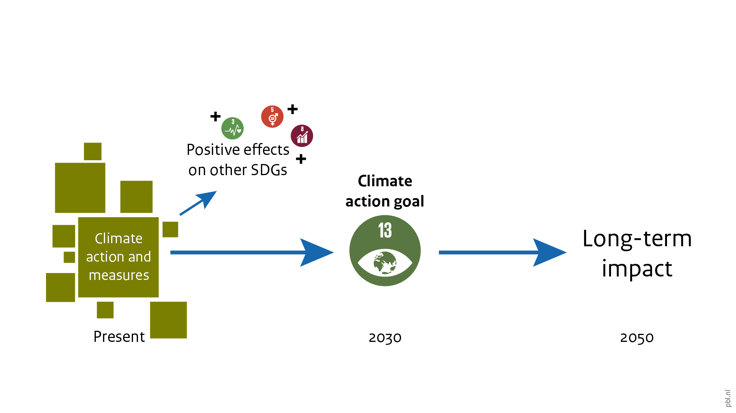
Effect of long-term climate action on SDGs
Notes:
These measures also affect other SDGs. Some of these effects are positive: climate mitigation also helps to achieve other SDGs on the way.

Slide 6
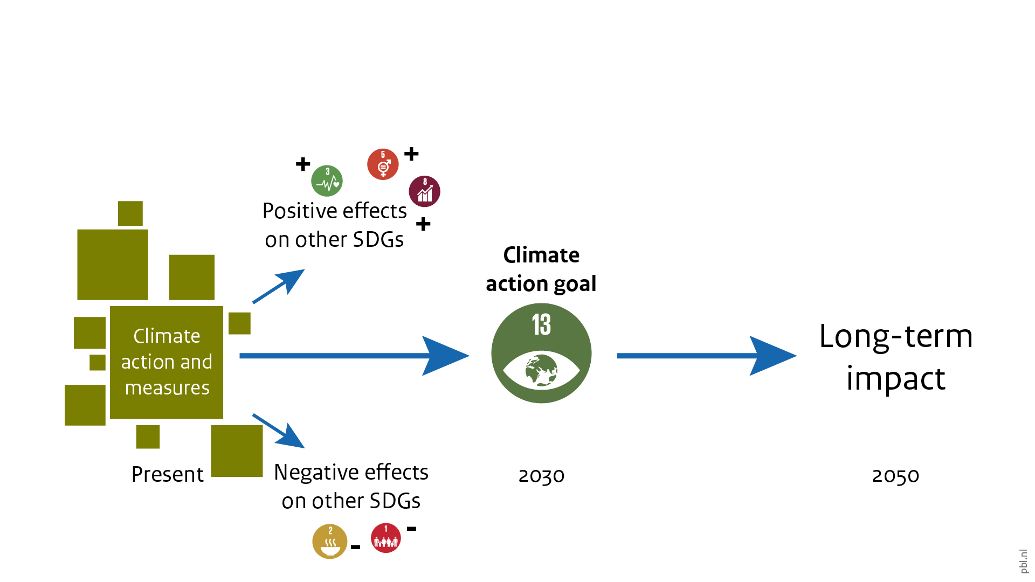
Effect of long-term climate action on SDGs
Notes:
But there may also be undesirable effects, with climate measures negatively affecting other SDGs. Making these synergies and trade-offs explicit can help to seize related opportunities and manage the trade-offs. While certain trade-offs may be avoided, this is not always possible — in which cases, trade-offs require a considered political decision and possibly complementary policies that reduce negative effects. Of course, not taking climate action also has undesirable effects.

Slide 7

Mitigation potential of good practice measures
Notes:
PBL has analysed several ‘good practice’ measures, in various sectors. This slide shows the global emission reduction potential in the sectors with measures that have been implemented in one or more countries and demonstrated noticeable impact on greenhouse gas emissions. These reductions are in addition to those related to currently planned and implemented policies.
(See also the PBL-report Climate change measures and sustainable development goals)

Slide 8
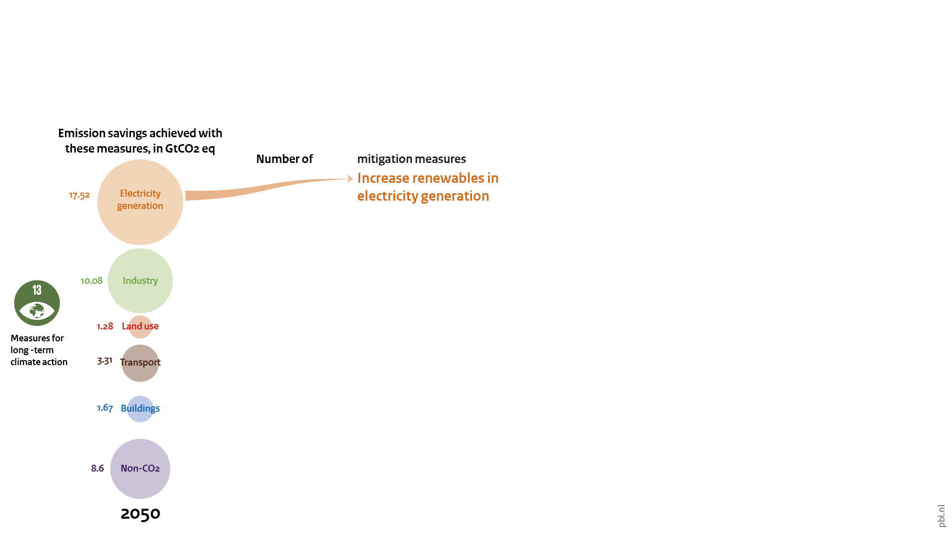
Promising climate mitigation measures
Notes:
There are various promising climate change mitigation measures in every sector. The measures analysed here have been implemented in one or more countries and demonstrated a noticeable impact on greenhouse gas emissions. The measures are designed in consultation with national experts, go beyond the traditional cost-optimal pathways and can be implemented more broadly in the 2020–2030 period. If scaled up, these good practice policies might be a more feasible and convincing strategy for climate change mitigation than a purely cost-optimal strategy.
Halting the use of coal-fired power plants without CCS and increasing the use of renewables (in the power sector) show the largest global emission reduction potential. Increased energy efficiency and installation of CCS in the industrial sector show the second-largest emission reduction potential. The industry sector is especially important in Central and South America, Europe, and South Asia. Measures in the non-CO2 sector also lead to large emission reductions in all regions. There is also significant emission reduction potential in the transport sector (in particular in North America and MENA regions), the building sector (especially in developed regions), and in land use (i.e. halting deforestation and increasing afforestation and reforestation, particularly in Southeast Asia and Sub-Saharan Africa). Reduction results in land use are strongly dependent on the scale (how much), rate (how fast) and duration (how long) of implementation. For the emission savings calculated here, we assumed an increase in forest area, between 2015 and 2030, at an annual rate of 2% in Central and South America, 1% in South Asia, Southeast Asia and Sub-Saharan Africa, and 0.5% in Europe and North America.

Slide 9
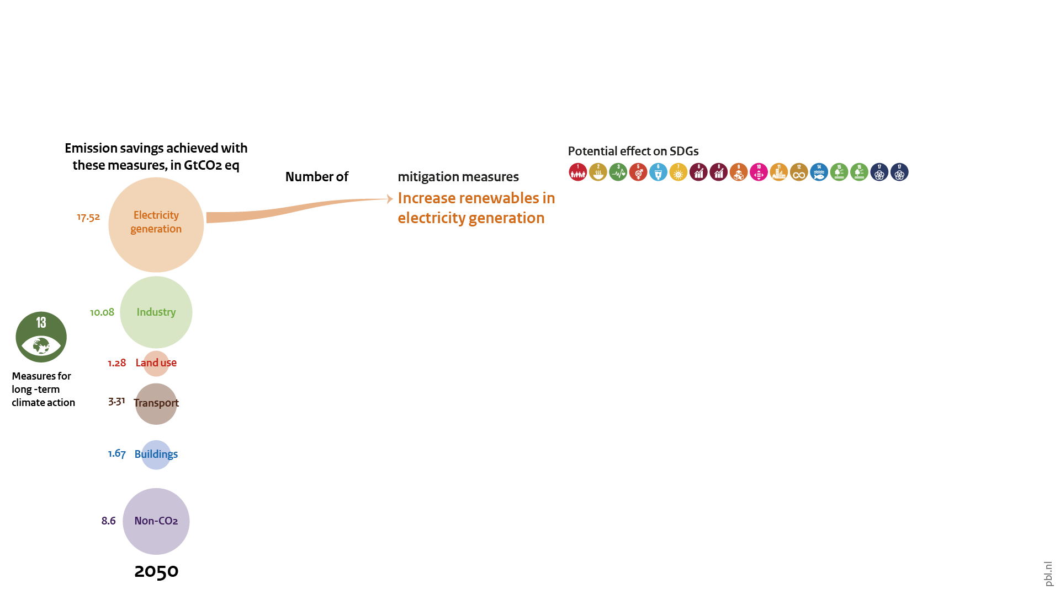
Potential synergy and trade-offs across the SDGs
Notes:
The most important synergies and trade-offs of these measures with other SDGs for selected world regions have been identified based on an extensive literature review. The SDGs are underpinned by no less than 169 targets, hence, an assessment of the interlinkages with all targets would be infeasible. Some choices must be made in selecting not only the SDG targets but also evaluating co-benefits and trade-offs, as there is an almost endless number of them. Therefore, the slide shows only the most direct co-benefits and trade-offs. Only for SDG 8 (decent work for all and inclusive and sustainable economic growth) and SDG 15 (sustainably manage forests/combat desertification and halt biodiversity loss), separate goals are defined, as different synergies and trade-offs were identified for these goals. Note SDG13 is not included: after all, by definition the measures here have positive effects on SDG13.

Slide 10
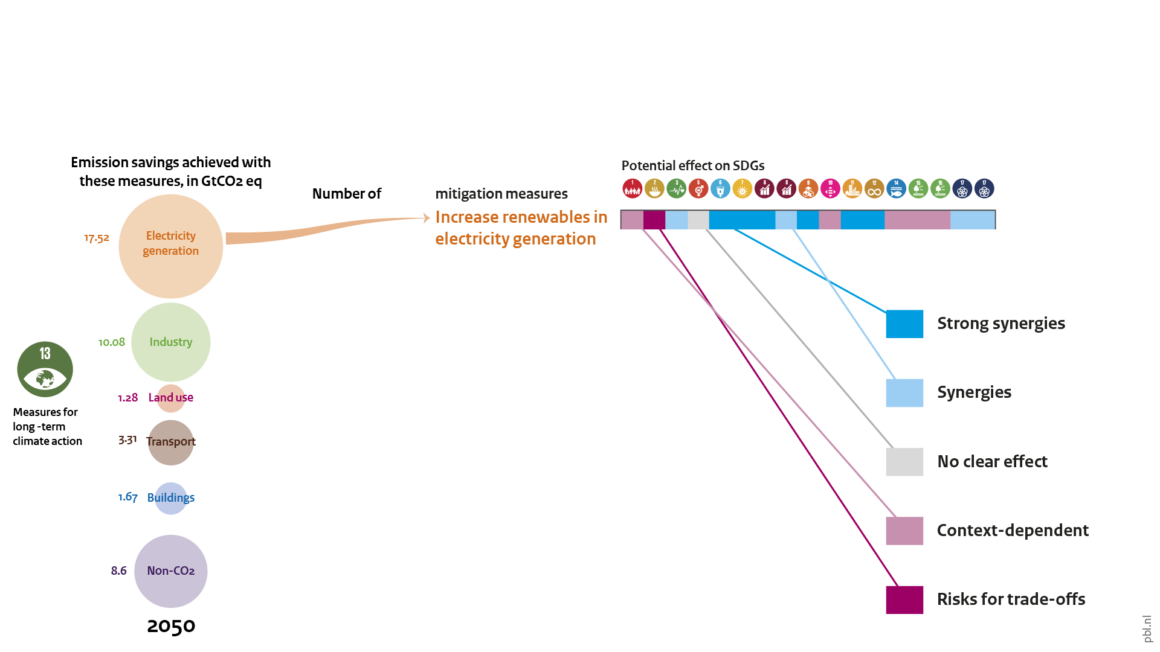
Short-term synergy and trade-offs per SDG
Notes:
The legend on the right shows the colour code of the evaluation for synergies and trade-offs. Cells with a blue colour indicate that potential co-benefits outweigh potential trade-offs. A light purple shading means that both synergies and trade-offs are possible, depending on the chosen technology or the regional context. A dark purple shading means there are more potential trade-offs than potential co-benefits.

Slide 11
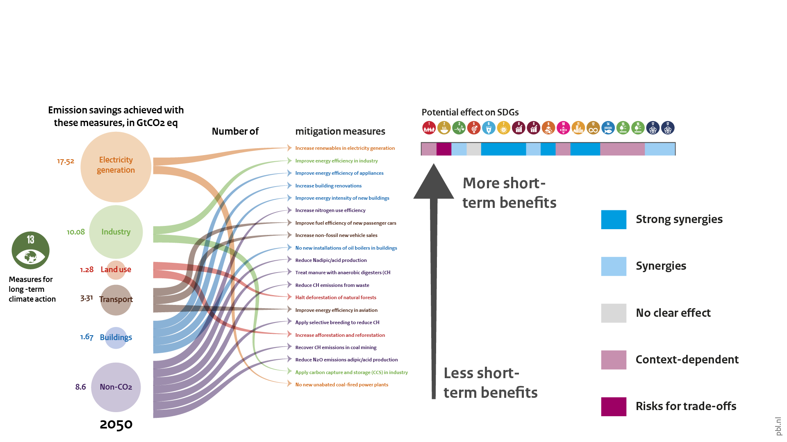
Short-term synergy and trade-offs per SDG
Notes:
Looking at the entire list of promising climate mitigation measures, the ones higher up the list can be seen to have the most additional short-term benefits for other SDGs. Those lower down the list have fewer or more variable short-term effects.

Slide 12
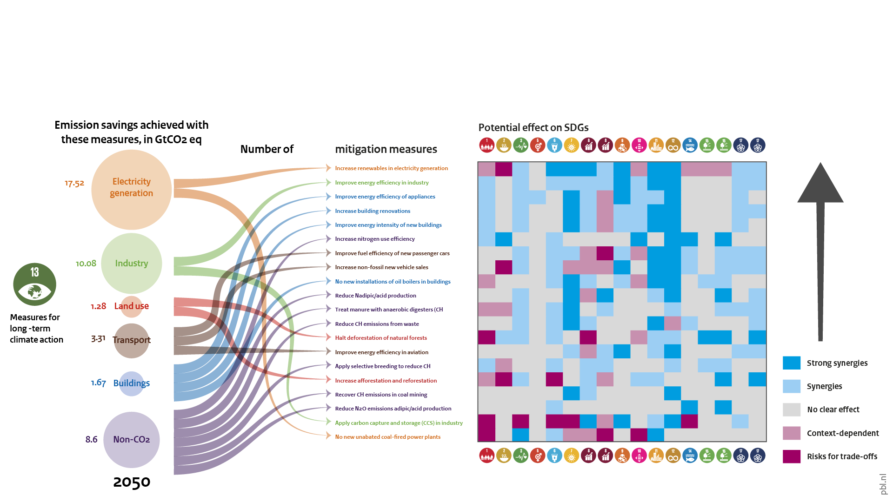
Short-term synergy and trade-offs per SDG
Notes:
The selected climate change mitigation measures show significantly more co-benefits than trade-offs at the global scale. This is consistent with findings of other studies. However, the magnitude of these co-benefits and trade-offs varies according to regional and socio-economic context. Of the 20 measures analysed, increasing the share of renewable energy in electricity generation shows the most co-benefits with other SDGs in all regions. All selected measures in the buildings sector show many strong co-benefits with other SDGs. Some trade-offs were identified for measures in industry and transport, but also, here, the number of synergies is higher. For land use and non-CO2 related measures, it strongly depends on the type of measures taken.
(See also the PBL-report Climate change measures and sustainable development goals)

Slide 13
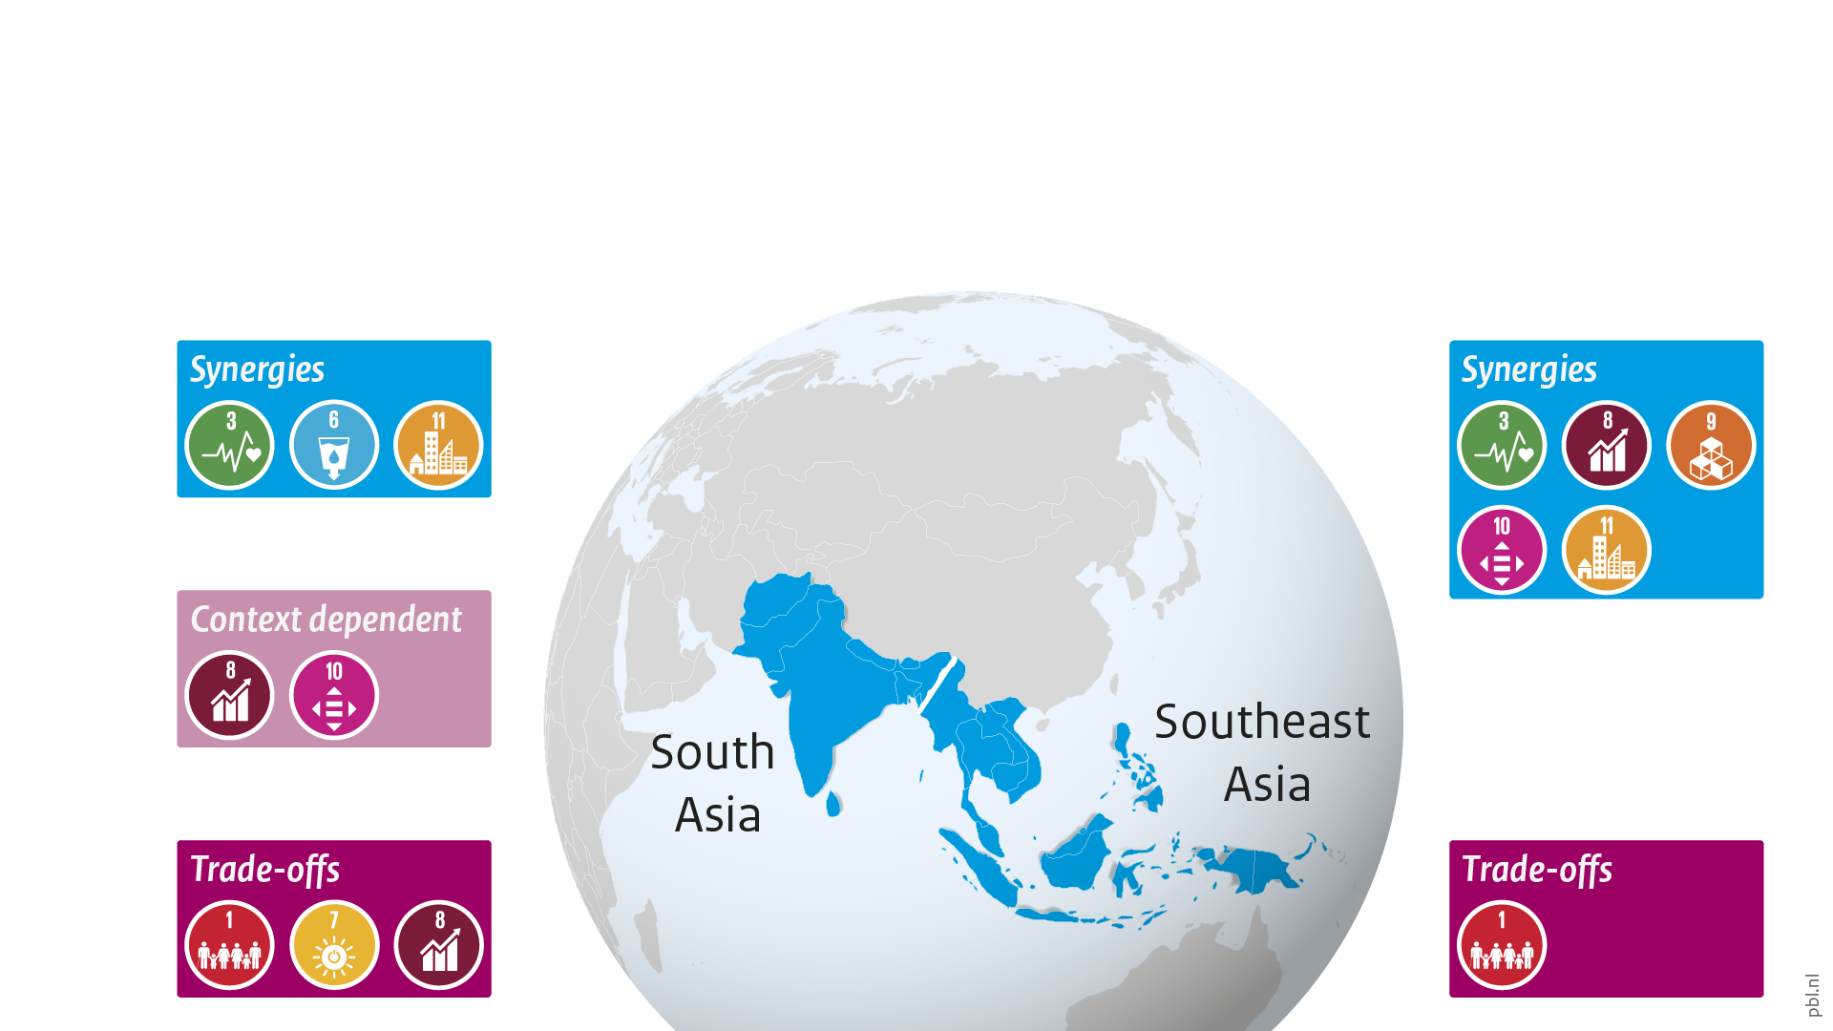
Measure: No new unabated coal-fired power plants
Notes:
This slide and following two show examples of regional variation between these synergies and trade-offs.
This slide shows that halting the construction of unabated coal-fired power plants has mostly synergies in Southeast Asia, whereas its effects in South Asia are partially context-dependent and include more trade-offs.
Halting the construction of unabated coal-fired power plants has clear synergies with reducing air pollution (SDG 11) and improving human health (SDG 3) in both South Asia and Southeast Asia. The health benefits are significant especially in dense urban centres of rapidly developing countries. Especially in South Asia, the resulting decline in coal use has a positive impact on water availability (SDG 6). In Southeast Asia, moving away from investing in unabated coal-fired power plants reduces the risk of stranded assets (SDG 8).
At the same time, coal has been the leading source of cheap and accessible energy in South Asia. Limiting the use of it could impact universal access to electricity (SDG 7). The decline in economic activities in coal mining and coal export could also have negative implications for employment in some parts of South Asia (SDGs 8 and 10). Locally, this may hamper poverty alleviation (SDG 1). In both regions, this measure could exacerbate poverty due to higher energy costs (SDG 1).
(See also the PBL-report Climate change measures and sustainable development goals)

Slide 14
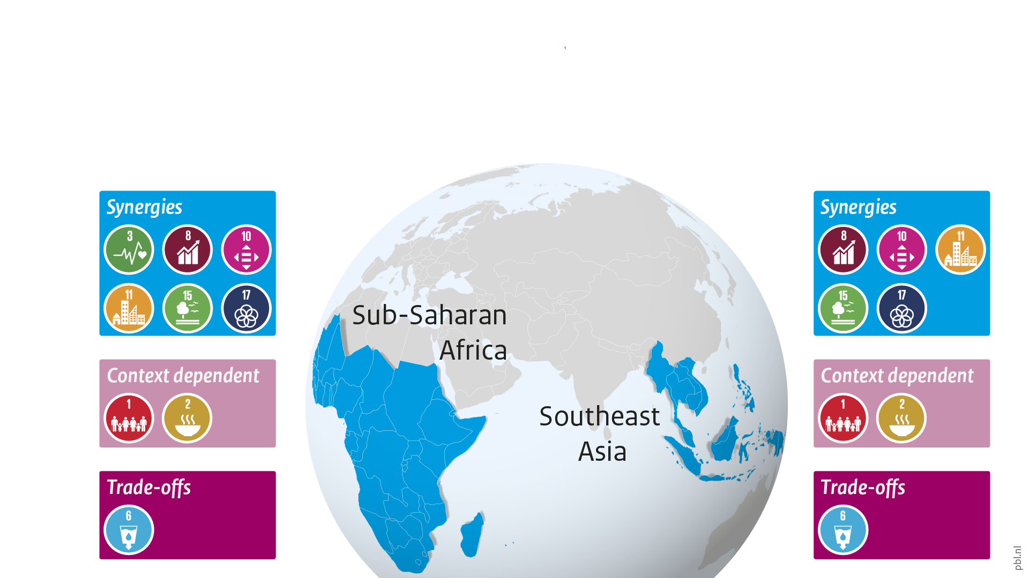
Measure: Increase afforestation and reforestation
Notes:
The effects of afforestation and reforestation in Southeast Asia and Sub-Saharan Africa combine socio-economic with environmental benefits, although a risk for trade-offs exists for water- and food-related SDGs.
Increasing afforestation and reforestation, as well as halting natural forest deforestation play a pivotal role in poverty eradication (SDG 1) by improving ecosystem services. Forestry generates jobs and increases the demand for forest products (SDGs 8 and 10). The measures also directly improve life on land by reducing soil erosion, water conservation, and improved soil organic matter and biodiversity (SDG 15). There is evidence that the measures improve air quality (SDG 11) and human health and well-being (SDG 3) in both regions and enhances the provision of food (SDG 2) and clean water (SDG 6) in Southeast Asia. Both afforestation and deforestation require international partnerships for financial and technological capacity building (SDG 17). However, these measures could result in an increase in agricultural prices (SDGs 1 and 2) as well as increase competition for water resources (SDG 6) in Sub-Saharan Africa and Southeast Asia.
(See also the PBL-report Climate change measures and sustainable development goals)

Slide 15
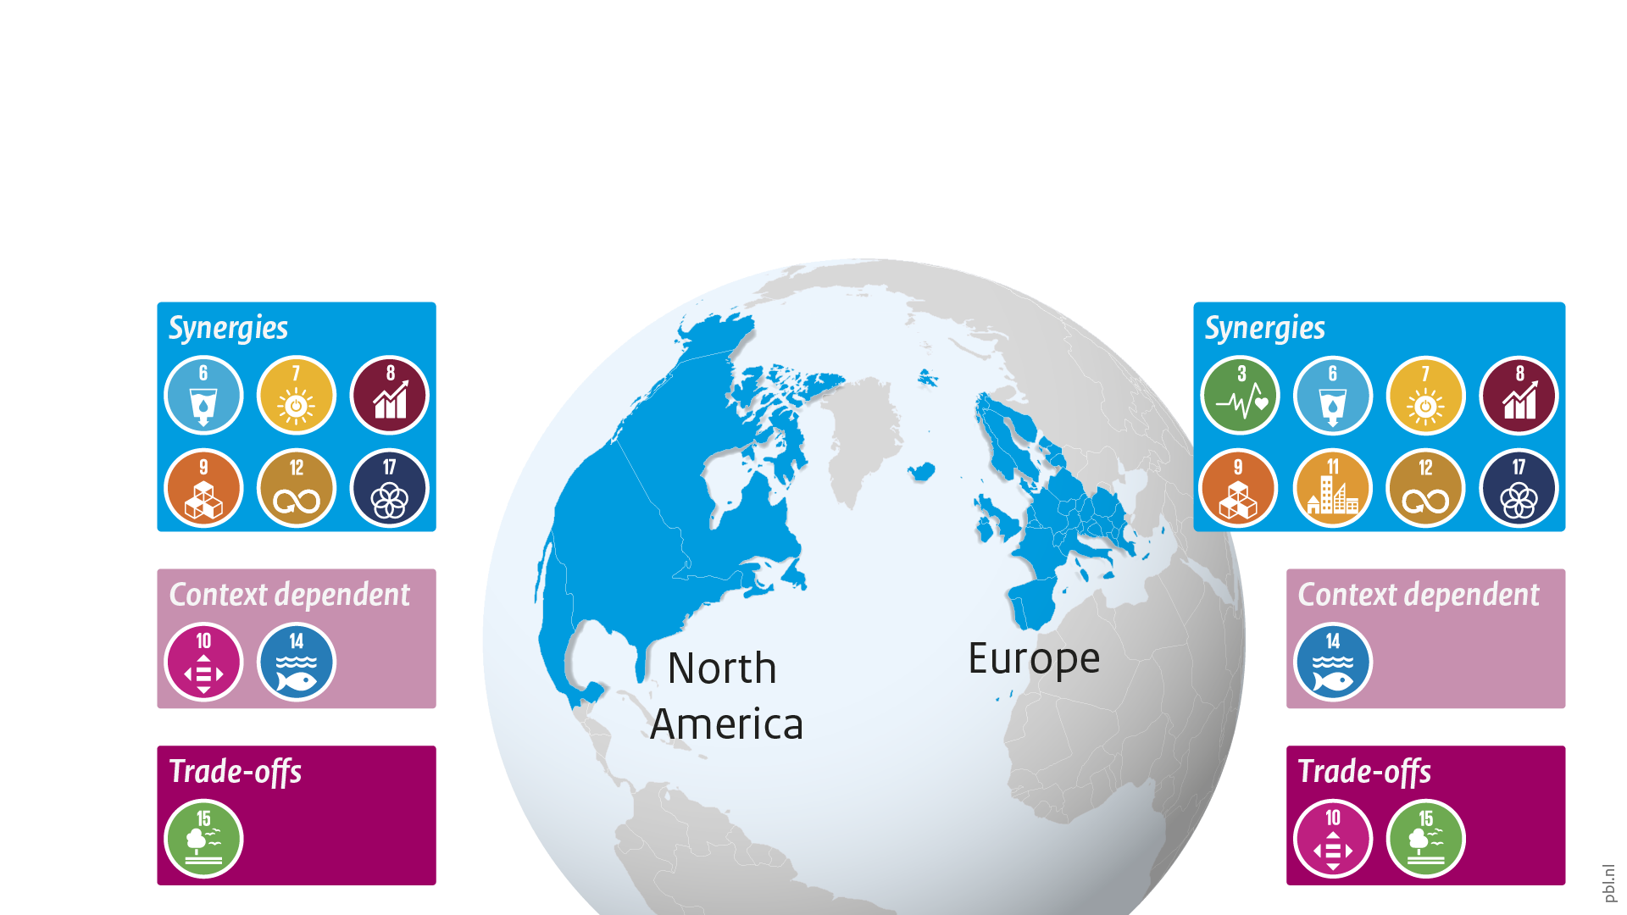
Measure: Increase renewables in electricity generation
Notes:
Increasing the share of renewables in electricity generation has a range of synergies with other SDGs in Europe and North America. Potential trade-offs are dependent on technology choices and cost effects for households.
Expanding renewable energy sources in power generation directly increases the share of renewable energy, improves energy efficiency, energy security, and access to clean fuels in parts of Mexico (SDG 7). The measure leads to improved water, air and soil quality by reducing emissions and leakage (SDG 6), especially relevant in the context of urban settlements in Europe (SDGs 3 and 11). Expanding renewable energy creates more jobs than fossil fuel technologies and stimulates the creation of decent and safer jobs (SDG 8). It contributes to economic growth and employment through the sourcing of local goods and services (SDG 17) and stimulates innovation (SDG 9). In general, renewable energy systems lead to less natural resource depletion (SDG 12) and ocean-based renewable energy systems enable marine resource protection (SDG 14).
At the same time, increasing the share of renewable electricity could result in a slight increase in electricity prices, due to the higher costs of some renewable technologies, more stringent emissions controls, and higher feedstock costs that could impact low-income households (SDG 10), while in parts of North America renewable sources are reaching price parity with or are becoming cheaper than fossil fuels. The trade-offs include the impact of wind turbines on biodiversity (SDG 15) and human health in densely populated areas (SDG 3). Utility scale renewable energy systems require large areas of land and may limit land availability and access to local communities (SDG 15). Finally, there may be competition between ocean-based renewable energy systems and other marine activities (SDG 14).
(See also the PBL-report Climate change measures and sustainable development goals)

Slide 16
Effect of long-term climate action on SDGs
Notes:
This presentation started from the connection between measures taken now for long-term goals, and their effects on SDGs in the nearer future. As the previous slides show, there are many more synergies than trade-offs. However, this distribution of effects is not equal between all issues and groups. The most prominent trade-offs are found in measures relating to land use and agriculture, which may hamper poverty alleviation and food security. These effects are most strongly felt by small-scale farmers and other low-income groups.

Slide 17
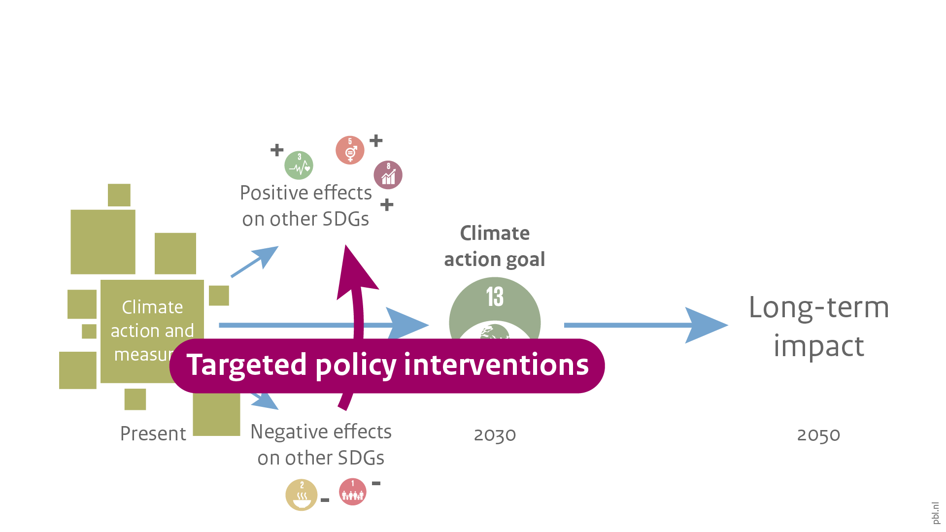
Effect of long-term climate action on SDGs
Notes:
These consequences can be limited with the help of targeted policy interventions that improve the socio-economic position of low-income groups. Such policies include programmes aimed at capacity building,and strengthening farmer rights, as well as improving access to decision-making, credit and ecosystem services.

Slide 18
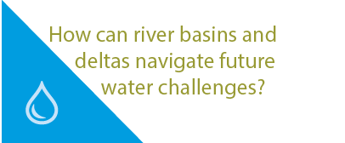
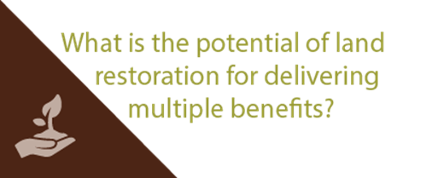

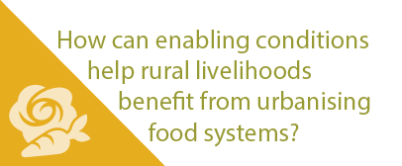
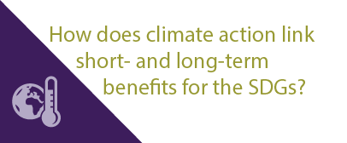
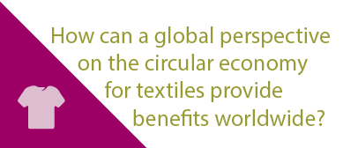
More stories at pbl.nl/ig22
This presentation

