Slide 1

How to tap into the learning potential of landscape approaches?
Notes:
Landscape approaches are increasingly being looked at by policies for international development. At the same time, the growing maturity of landscape approaches is only gradually translating into increased attention for the learning processes they involve. The following slides set out different forms of learning that can be found within landscape approaches and beyond.

Slide 2
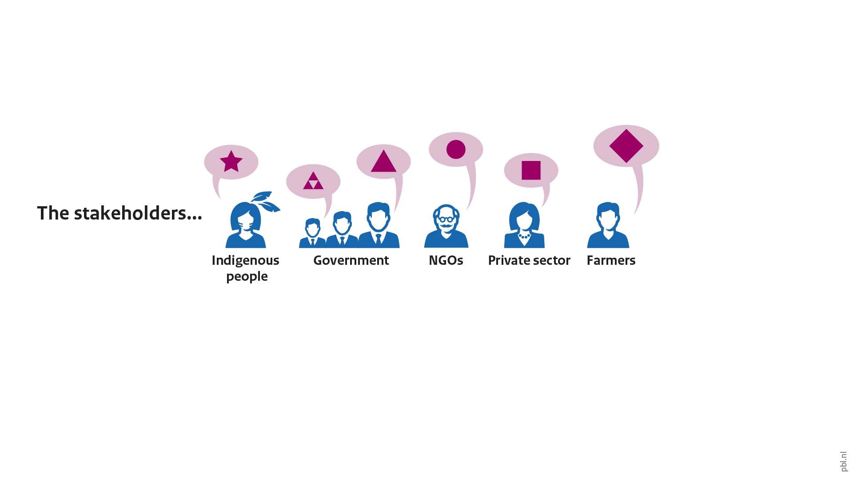
The promise of landscape approaches
Notes:
Landscape approaches seek to bring together different actors from a particular area. These actors are often active in different sectors, and as such can have different or even conflicting interests and goals.

Slide 3
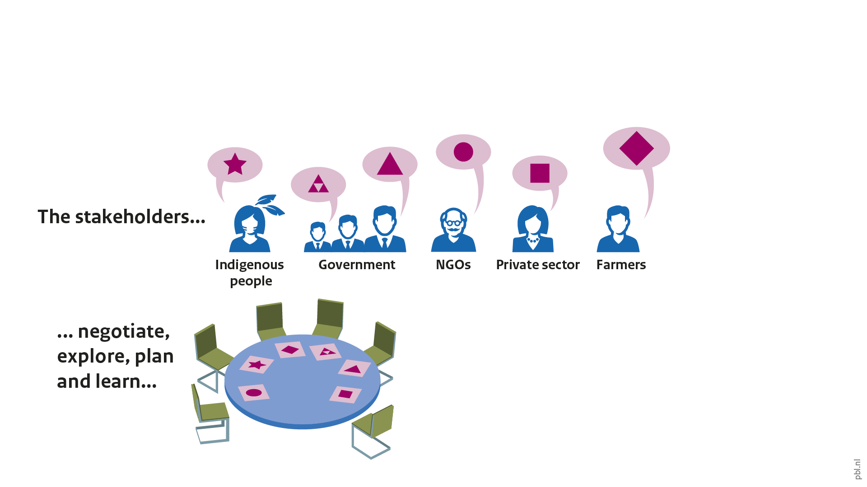
The promise of landscape approaches
Notes:
Together, these actors discuss their visions for the region. This helps to articulate potential synergies and trade-offs between these visions, and thereby enables the actors to come to a shared understanding of what is at stake in the landscape. This iterative process of collaborative planning and exploring potential development pathways creates opportunities for the actors to learn about different solutions and the conditions under which they might be successful.

Slide 4
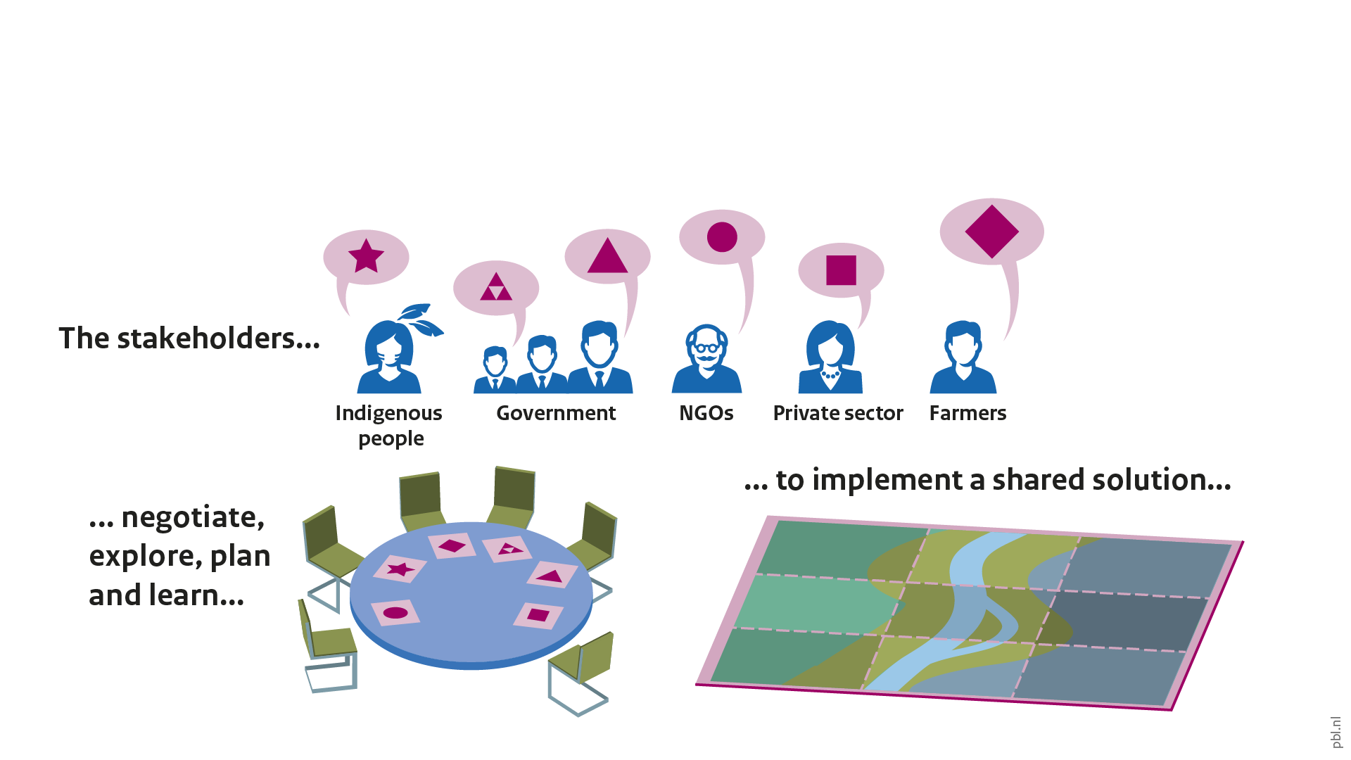
The promise of landscape approaches
Notes:
Aside from discussing and learning about solutions, the actors collaborate on plans to actually realise them. What actions are required to make the shared vision a reality?

Slide 5
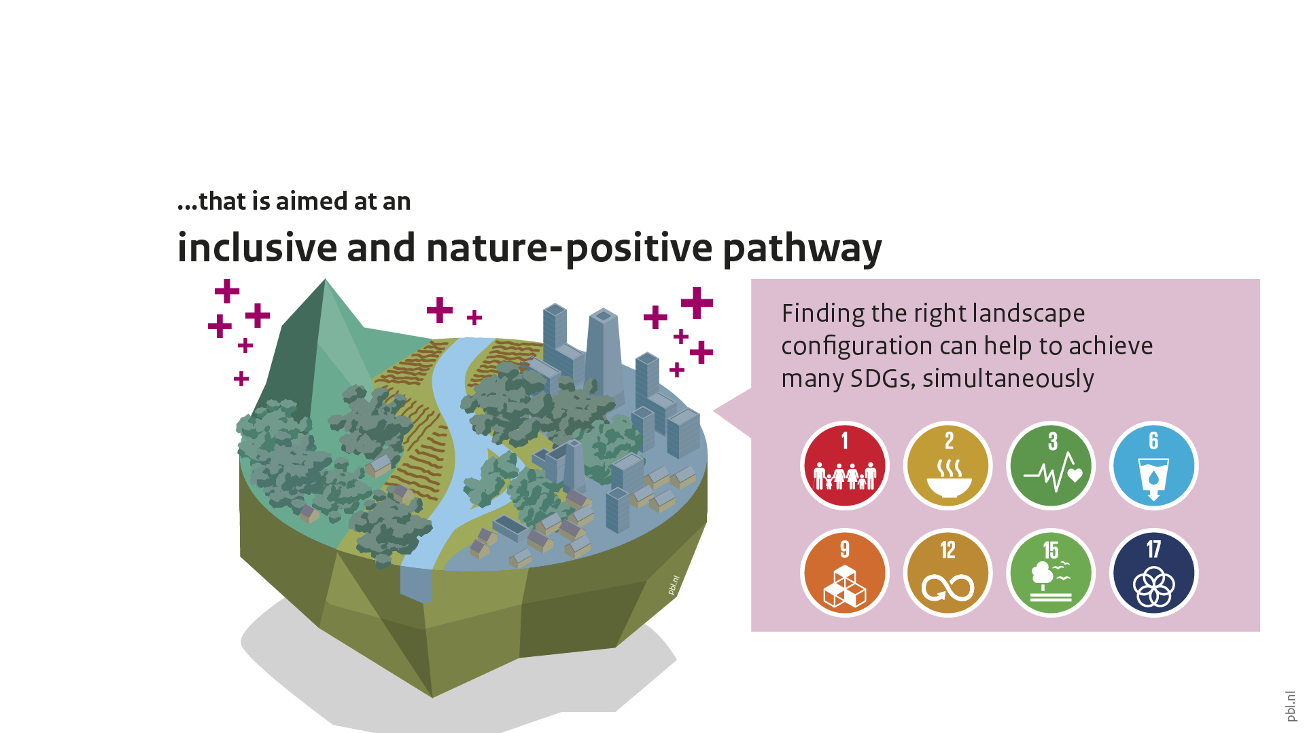
The promise of landscape approaches
Notes:
When successful, landscape approaches hold the promise of finding locally owned solutions that combine progress towards multiple SDGs, simultaneously. Of course, ideally, we would see as much as possible of these solutions shared and exchanged between landscapes, to increase the positive impact and avoid others having to re-invent the wheel. In other words, what is the potential for learning beyond the landscape itself?

Slide 6
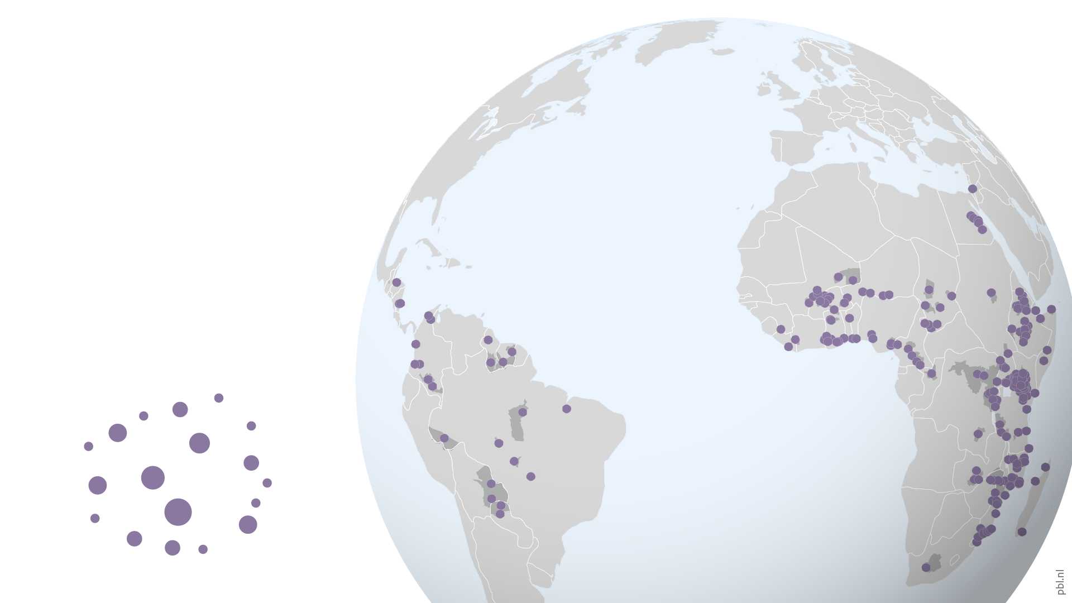
Portfolio of landscape approaches
Notes:
This map shows locations in which landscape approaches are funded by the Dutch Ministry of Foreign Affairs. This highlights a potential for learning outside of the initiatives themselves. This potential is threefold.

Slide 7
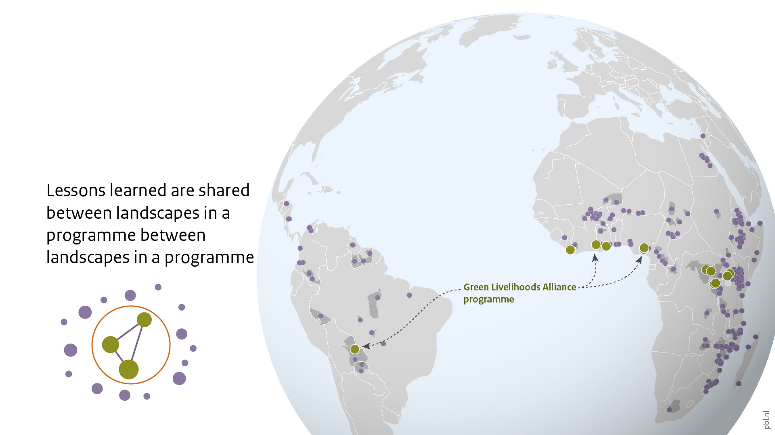
Learning between landscapes
Notes:
The first part of this potential stems from the fact that different landscapes can be involved through a single programme or funding source. For instance, the landscapes highlighted on this slide are all part of the Green Livelihoods Alliance programme by the Dutch Ministry of Foreign Affairs. In such programmes, exchange between participating landscapes can yield lessons, tools and best practices that can circulate between the landscapes involved in the programme.

Slide 8
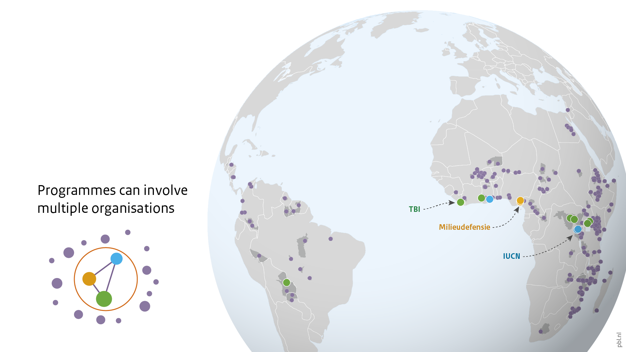
Learning between landscapes
Notes:
At the same time, a programme may be composed involving multiple organisations. For instance, this slide shows the different organisations involved in the Green Livelihoods Alliance programme.

Slide 9
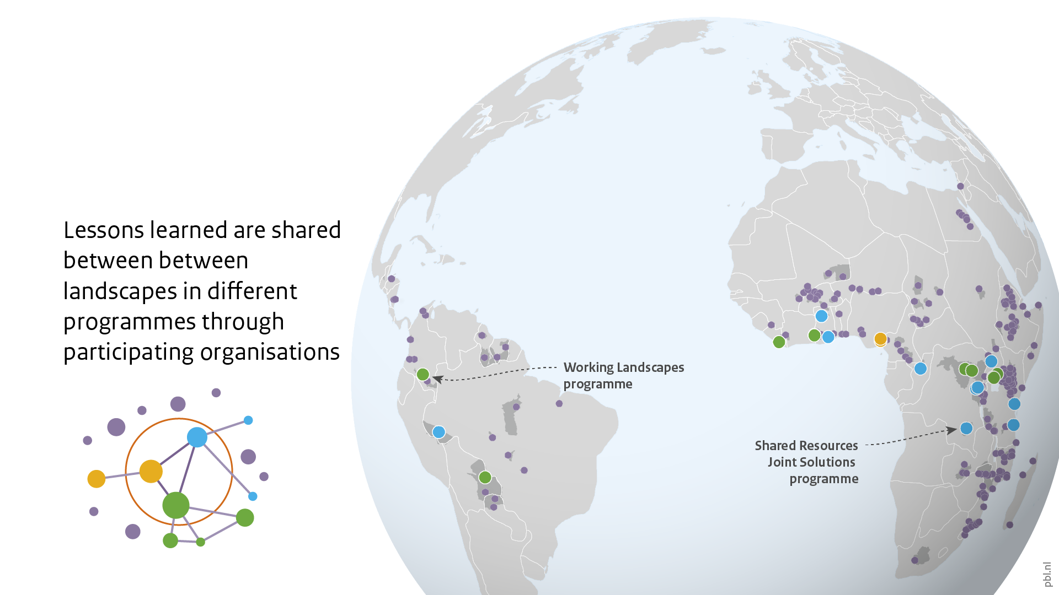
Learning through actors involved
Notes:
This leads to the second learning potential around landscape approaches. The organisations involved in landscapes can share lessons, tools and best practices with other landscapes and programmes, through their own experience and knowledge management. In this way, lessons can be applied beyond the direct context of a funding programme. To illustrate this learning through actors, this slide shows all landscapes in which one of the partners in the Green Livelihoods Alliance is active.

Slide 10
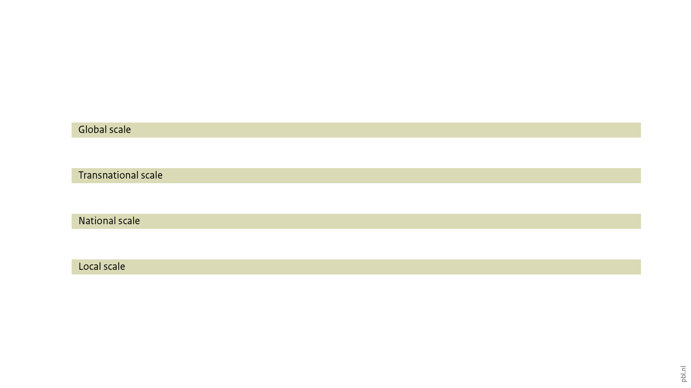
Global goals and local solutions
Notes:
The previous slides show learning opportunities within the networks of organisations active in landscape approaches. However, much of governance takes place at different scales, from global to local. This creates the third learning potential from landscape approaches that go beyond individual landscapes.

Slide 11
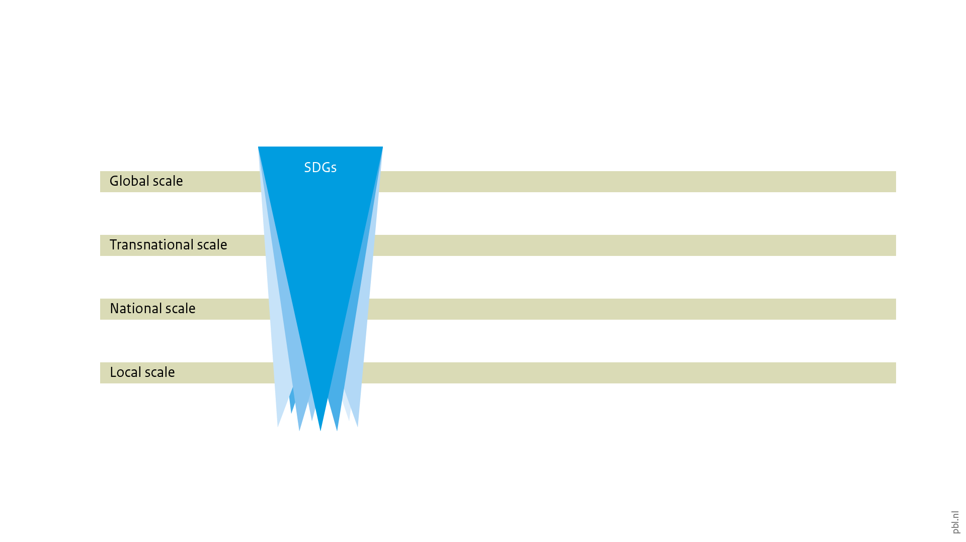
Global goals and local solutions
Notes:
In this multi-level type of governance, the SDGs can be seen to extend from the global level all the way down to the local landscape. But in this process, the integrated ambition of the SDGs often meets practical barriers that mean reality is more silo-ed.

Slide 12
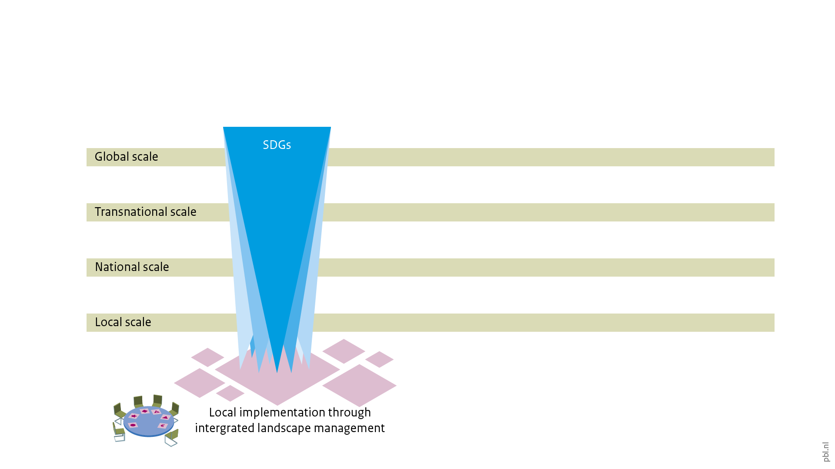
Global goals and local solutions
Notes:
As already pointed out above, landscape approaches are a way to bring these different SDGs back together into integral solutions.

Slide 13
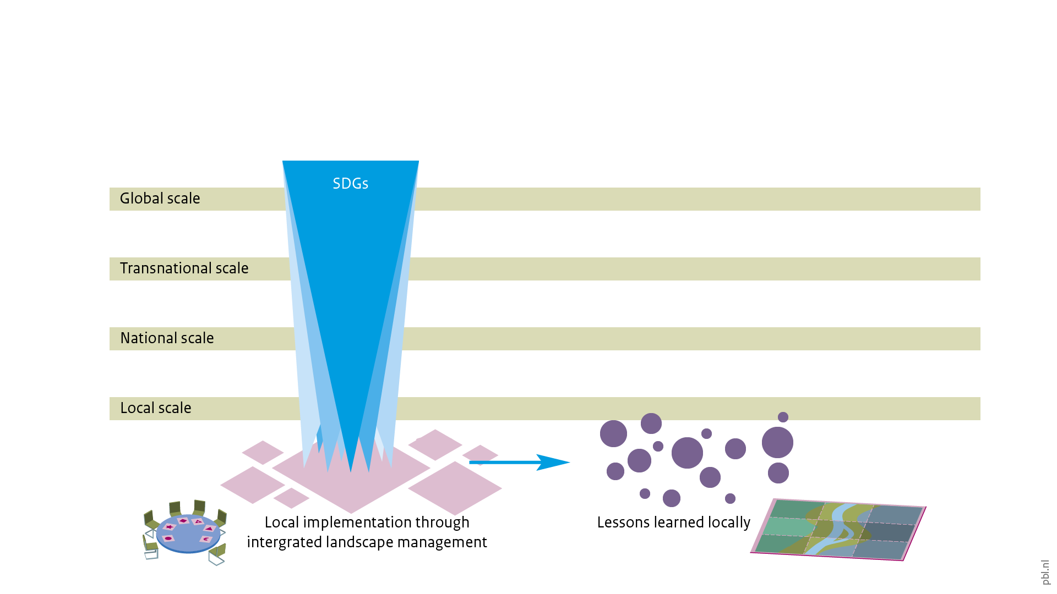
Global goals and local solutions
Notes:
These solutions yield lessons, which hopefully can be shared through the programmes and organizations involved in applying landscape approaches.

Slide 14
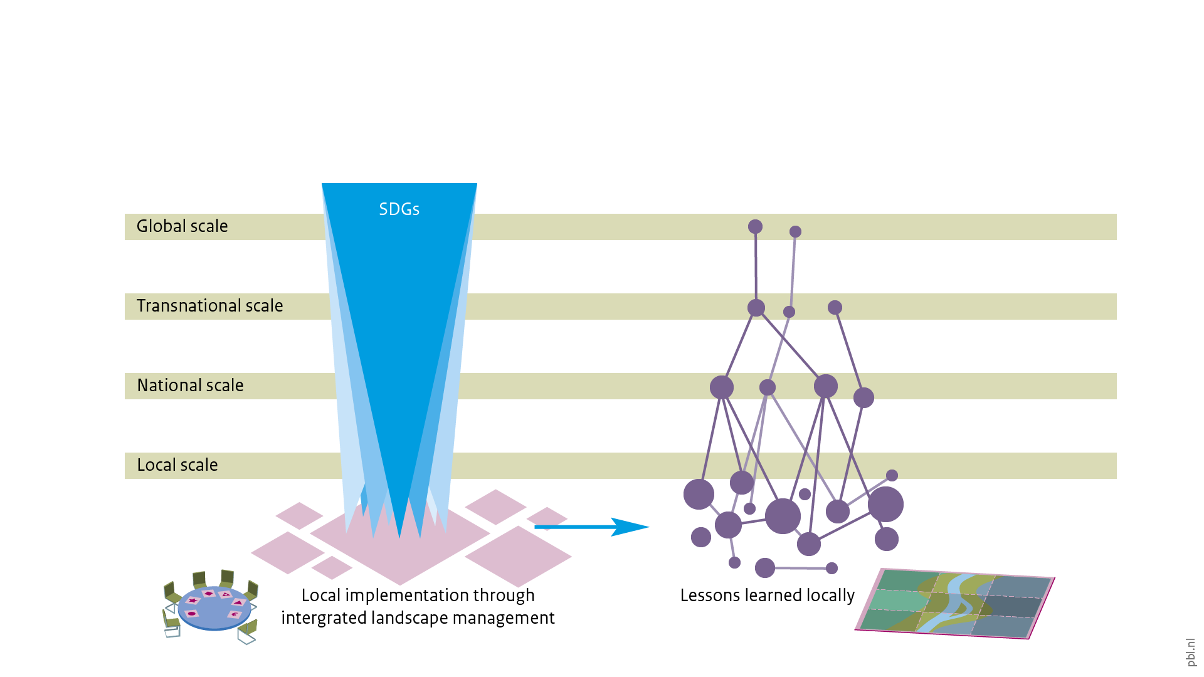
Global goals and local solutions
Notes:
But some of these lessons may require action on different scales. For instance, through changes in national legislation that enable a solution to be implemented, or through the standards and definitions contained in multilateral trade agreements. In other words, lessons need to be drawn together and filter back up to other levels. This requires dedicated work that can be undertaken, for instance, by researchers, knowledge brokers, or policymakers.

Slide 15
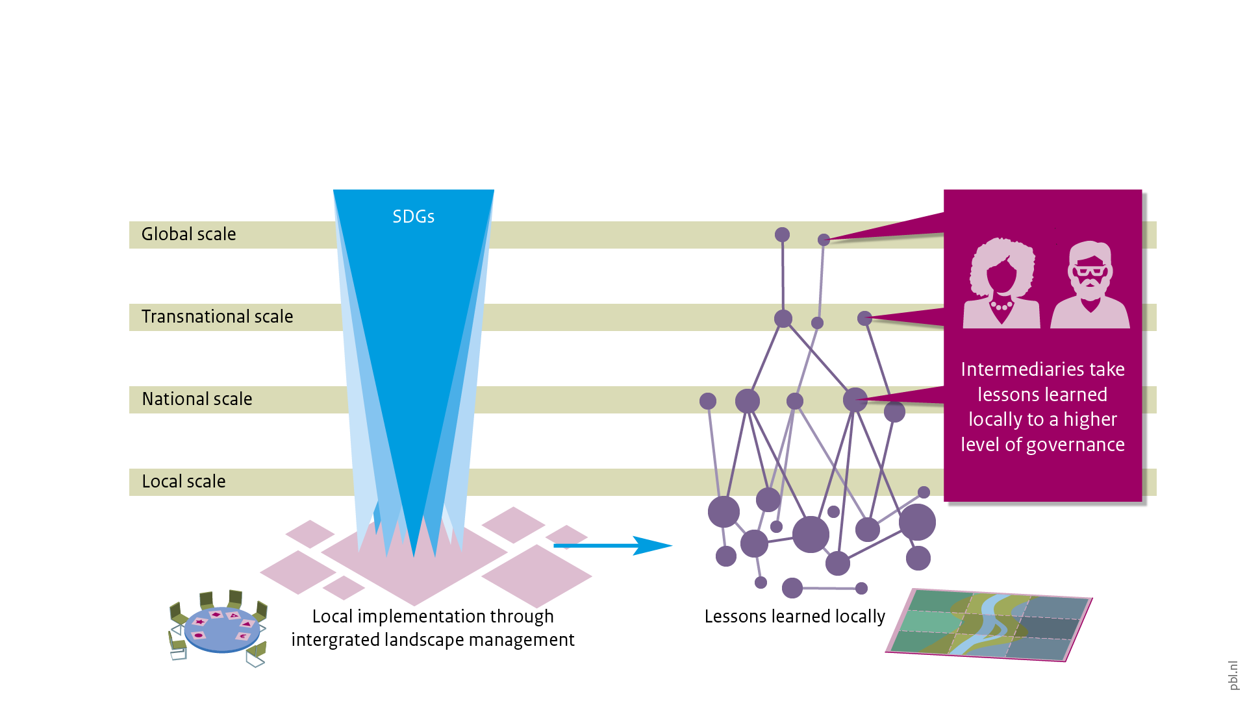
Global goals and local solutions
Notes:
In fact, some actors are active at different levels at the same time, making them particularly well-placed to take on this intermediary role. For instance, staff at Ministries of Foreign Affairs often have networks and connections that range from the very local to the global level, through their links to embassies, international organisations, as well as their country’s foreign policy.

Slide 16

Global goals and local solutions
Notes:
In this way, a cycle of learning emerges in which global goals and local solutions can mutually inform each other.

Slide 17
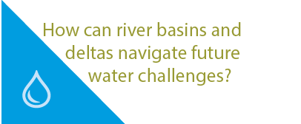
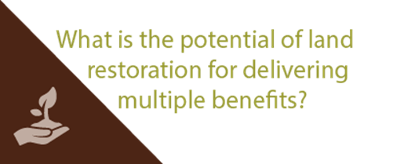
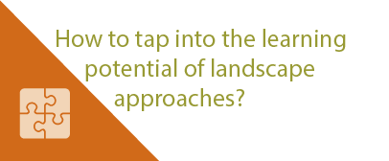
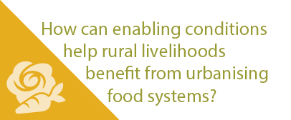
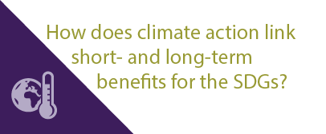
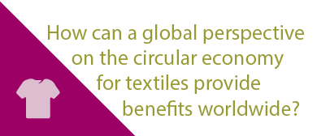
More stories at pbl.nl/ig22
This presentation

