Slide 1
How to navigate river basins and deltas towards a sustainable future?
Notes:
Water is one of the most important resources for humankind. It is a prerequisite for life on our planet and flows across many social, economic and environmental activities; now and in the future. Climate change affects the water cycle, resulting in changing weather patterns and an increase in the frequency and intensity of weather extremes, such as droughts, flooding, tropical storms, heatwaves and cold waves, and heavy precipitation events.

Slide 2
Water is related to all Sustainable Development Goals
Notes:
In 2015, the world agreed on a set of global goals in the Sustainable Development Goals. Water is linked to these global commitments, in many ways.

Slide 3
Water is, more or less, related to all Sustainable Development Goals
Notes:
The link between water and the SDGs is particularly strong around freshwater supply, flood protection, water pollution, human health and well-being, food and energy production, biodiversity and climate change adaptation. For other SDGs, the link is indirect or not as strong.

Slide 4
Four water-related hotspot landscapes
Notes:
PBL’s publication Geography of Future Water Challenges maps the main risks and challenges related to these links between water and the SDGs. Examples include food production, water pollution and human health, flooding, conflict and migration, energy production and the quality of aquatic ecosystems. In combination, these risks and challenges define four global hotspot landscapes. These landscapes and their interdependencies provide a frame for building a more climate-resilient and sustainable world, on various scales.
(More information on the risks and challenges and hotspot landscapes can be found online at https://themasites.pbl.nl/future-water-challenges/)

Slide 5
Hotspot landscapes are interrelated
Notes:
Some of the key interdependencies are related to river dynamics, urbanisation, migration and the exploitation of freshwater resources.
Additional information on drylands
The global dryland population is projected to increase from around 2.8 billion, today, to 4 billion, by 2050. In drylands, increased water stress and crop yield gaps may contribute to increases in migration and the risk of local conflict. This is especially the case for Sub-Saharan Africa, for which a 40% increase in the rural population is projected, as well as a tripling of the urban dryland population.
Additional information on cities
By 2050, 70% of the world’s population is projected to live in cities. Large cities will double in size in Asia, and will see a twofold to fivefold increase in Sub-Saharan Africa, thus increasing the challenges of providing an adequate water supply and reducing water pollution. With respect to water services and water- and climate-related risks, reducing the inequity between the formal city and informal settlements will be a major undertaking.
Additional information on transboundary river basins
Although they cover only 0.8% of the Earth’s surface, rivers and deltas are immensely important for biodiversity, as they contain for instance around 40% of all described fish species, and their wetlands are the habitat of numerous bird species. Globally, 3700 new large dams are planned that will reduce freshwater biodiversity and sediment flows, and slow down the natural formative processes of deltas and coasts. Future hotspots are the Himalayan region, Yangtse River Basin, Congo Basin and Amazon Basin. In combination with an increase in water demand and pollution, these new dams may increase the pressure on transboundary collaboration in river basins.
Additional information on coastal zones and deltas
Population growth and economic development in flood-prone coastal areas will increase the challenges of preventing forced migration and economic losses related to long-term sea level rise. Flooding hotspots are projected in China, Southeast Asia, South Asia and Sub-Saharan Africa. Land reclamation and overexploitation of groundwater resources cause land subsidence and salinisation and strongly increase the future vulnerability of especially densely populated deltas.
(More information on river basins and deltas can be found online at https://themasites.pbl.nl/future-water-challenges/river-basin-delta-tool/)

Slide 6
A focus on river basins and deltas
Notes:
The relevance of rivers basins and their deltas to sustainable development is linked with freshwater supply, flood protection, water pollution, human health and well-being, food and energy production, biodiversity, and climate change adaptation and sustainable cities and communities. Achieving the Sustainable Development Goals (SDGs) calls for a more central position for improved water management and adaptation to climate change in development strategies and investment decisions on river basins and deltas.

Slide 7
Human interventions and climate pressures in river basins and deltas
Notes:
The ecosystem services on which the population in river basins and deltas depends are affected by population growth, climate change and ongoing economic development. Human interventions, such as urbanisation, dam construction, canalisation, surface water and groundwater abstraction, deforestation and land-use intensification, land reclamation, agricultural and industrial production, and polluting emissions all may disturb the natural dynamics of rivers and deltas, increase flood risk, and cause water pollution. The numerous dams and sluices and increased use of water disturb and often diminish the flow of water and sediment from the rivers to the deltas. This also increases the pressure on transboundary collaboration in river basins.
These interventions and climate pressures have an impact on all SDGs, as illustrated in the figure on the right. Most impacts are negative, but some SDGs are affected in both negative and positive ways. Rivers and deltas provide various options for employment, economic growth, industry, innovation and infrastructure. However, the increase in population and economic assets also increases flood risk, especially since investments are largely based on the 'old climate' (SDGs 8 and 9). And while more people have access to clean drinking water and sanitation, in large parts of Africa and Asia, this improvement cannot keep up with population growth (SDG 6).

Slide 8
Trends in river basins and deltas
Notes:
The enormous pressure on the quality of most river basins and deltas is unlikely to improve, between now and 2050. Under a business-as-usual scenario, achievement of the SDGs is slipping further out of reach — due to both climate change and human interventions. In particular, terrestrial and aquatic biodiversity (SDGs 14 and 15) is projected to deteriorate due to drought, higher water temperatures, disturbed sediment flows, unsustainable water and groundwater abstraction and further increases in nutrient emissions. The projected strong increase in hydropower will improve the achievement score for SDG 7 (Affordable and Clean Energy). Under the business-as-usual scenario, investments are limited in the conditional SDGs on Climate Action (SDG 13) and Partnerships for the Goals (SDG 17). Climate change and sustainable development are fundamentally connected, as the former can undermine the latter.
The good news here is that we could bend the trend, if we change the way we manage our rivers and deltas and our terrestrial water and groundwater resources. To succeed, it is of paramount importance that we aim for sustainable development and work in the same direction, across all levels and scales. Using the set of SDGs as an inspiration may help to make a change towards more inclusive, sustainable and climate-robust development strategies, plans and projects.

Slide 9
Flood risk: Low ambition - Technical solutions - Adapted to climate change - Not adapted to socio-economic change
Notes:
Under a business-as-usual scenario, the global number of people exposed to river flooding will increase by 65%, to 108 million a year by 2050. Flooding has strong links with many of the SDGs. Flooding events, for instance, may lead to loss of life and economic damage, increases in waterborne diseases, destruction of buildings and the disruption of critical infrastructure for water and food supply and transport — all of which are linked to SDGs 1, 2, 3, 8 and 11. In many countries, the population in formal cities and informal urban settlements is unequally exposed to flood risks (SDG 10). Adequate adaptation to climate change in flood risk strategies (SDG 13) is of great importance to increase the resilience to flooding. Using nature-based solutions in adaptation strategies can support the ecological quality of freshwater and coastal ecosystems (SDGs 15 and 14, respectively). There are numerous strategies and measures to reduce the risks of river and coastal flooding. Two examples of potential pathways are provided in this slide and the following one (with a low and a high ambition pathway, respectively).
In the low ambition pathway, flood protection is adapted to the changing climate, such that flood probability stays the same, from 2010 to 2050. Along this pathway, SDG 13 (Climate action) is coloured in green. However, flood risk still strongly increases as a result of socio-economic developments, so that there is little to no contribution to other SDGs. For example, groundwater extraction continues to cause subsidence in coastal areas, while houses and industries continue to be built in flood-prone areas.

Slide 10
Flood risk: High ambition
- Nature-based & technical solutions - Adapted to climate change - Also adapted to socio-economic change
- Reducing flood risk inequality
Notes:
The high ambition pathway contains substantially higher protection standards, is also adapted to socio-economic development, has additional protection of urban areas and uses nature-based solutions and water-resilient spatial development. This pathway contributes very positively to most of the SDGs. It particularly requires a transformation in working with strong institutions (SDG 16 Peace, Justice and Strong Institutions), partnerships (SDG 17 Partnerships for the Goals) between government authorities, the private sector and society at large, and well-organised inclusive development processes.

Slide 11
Adaptive pathways for sustainable river basins
Notes:
Getting serious about sustainable and climate-resilient development requires fundamental changes in policy development, planning and investment decisions, on all scales. To this end, adaptive pathways towards the future need to be carved out that avoid dipping into the ‘unsustainable space’ shown. Crucial, in this respect, is that the pressures and the definitions of what is sustainable and unsustainable may change, over time, due to external environmental, economic, political, or societal developments.

Slide 12
Adaptive pathways for sustainable river basins
Notes:
Current policies present one pathway along which we are proceeding through this space.

Slide 13
Adaptive pathways for sustainable river basins
Notes:
At times, decision points emerge. These points can occur naturally when major policy decisions need to be made or can be event-driven, for instance, reacting to environmental disasters or social and economic disruptions. But decision points can also emerge when there are signs that the current pathway is headed towards an unsustainable space.
These are essential elements for navigating river basins and deltas towards a climate resilient and sustainable future:
Adopt a scope and responsibility for the whole system, stretching from headwaters to coastal seas;
Adopt a 100-year perspective for developing adaptive pathways, accounting for future uncertainties;
Engage all relevant public, private and societal stakeholders to develop a shared vision;
Integrate climate change adaptation and other main river stressors in every aspect of the policy development affecting the functioning and qualities of the river system.
Continue to strengthen and innovate and periodically reassess the situation and long-term strategy. (Are we doing the things right? Are we doing the right things?)

Slide 14
Adaptive pathways for sustainable river basins
Notes:
These decision points can be grasped to assess what it would mean to continue down the current pathway, such as is shown in the preceding slides. In that way, it may become clear that this pathway would indeed lead into an unsustainable space, and that policy adjustments are required to prevent this.

Slide 15
Adaptive pathways for sustainable river basins
Notes:
Periodically, the decision points should provide a moment to map and consider possible future pathways more broadly. What other courses of action are possible, and for how long will they present a viable pathway? This broad mapping of pathways navigating towards a climate-resilient and sustainable future creates an impetus for integrated policy development, breaking away from traditional sectoral silos. Each decision, therefore, should be transparent about the coherence and interdependencies across policy domains and its contributions to the SDGs, with a particular focus on long-term climate resilience, ecosystem qualities and biodiversity and social implications.

Slide 16
Adaptive pathways for sustainable river basins
Notes:
Regularly repeating such assessments of pathways creates an iterative and adaptive process, which helps policy stay within the sustainable space, in the face of uncertainty and complexity.

Slide 17
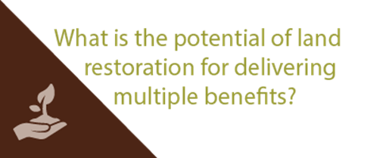
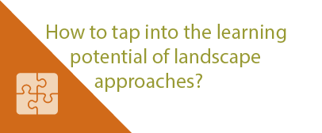
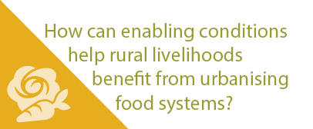
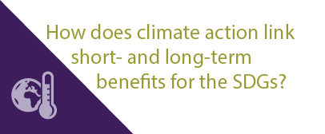
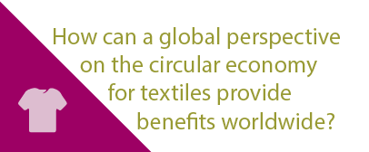
More stories at pbl.nl/ig22
This presentation

